Slide 1

Notes:
Slide 01: Cover

Slide 2
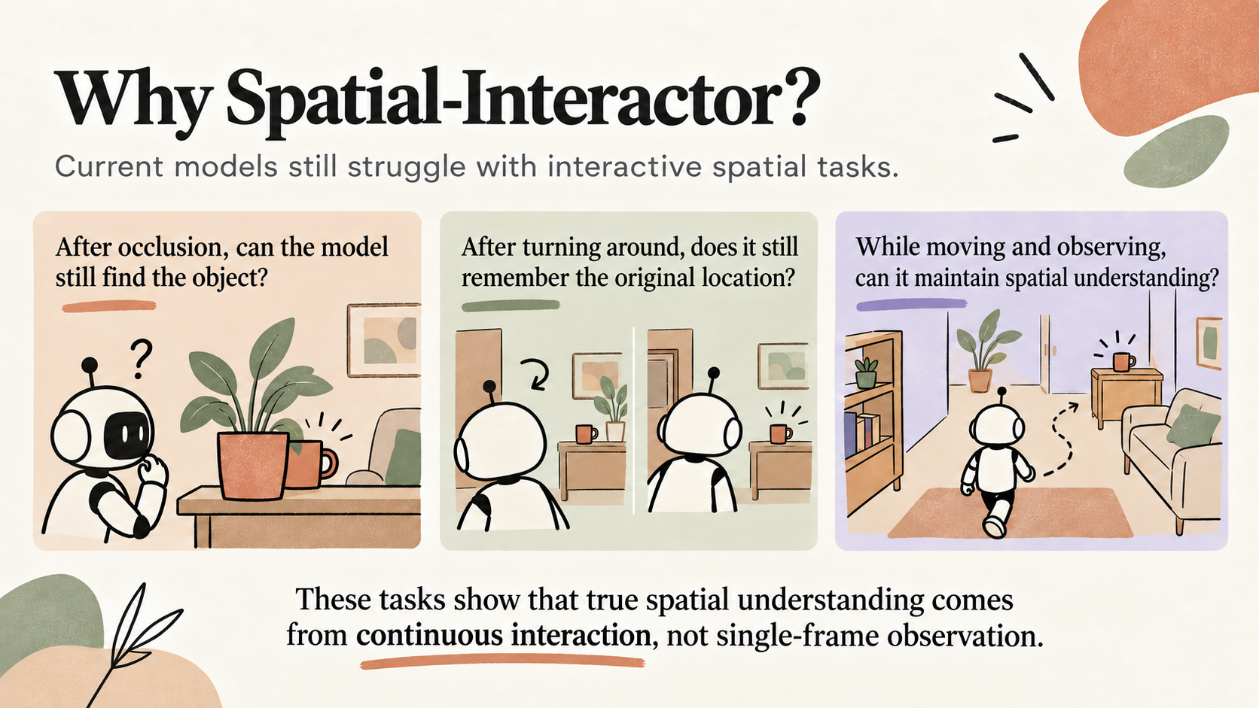
Notes:
Slide 02: Why Spatial Interactor
English version of the user-approved replacement page.

Slide 3
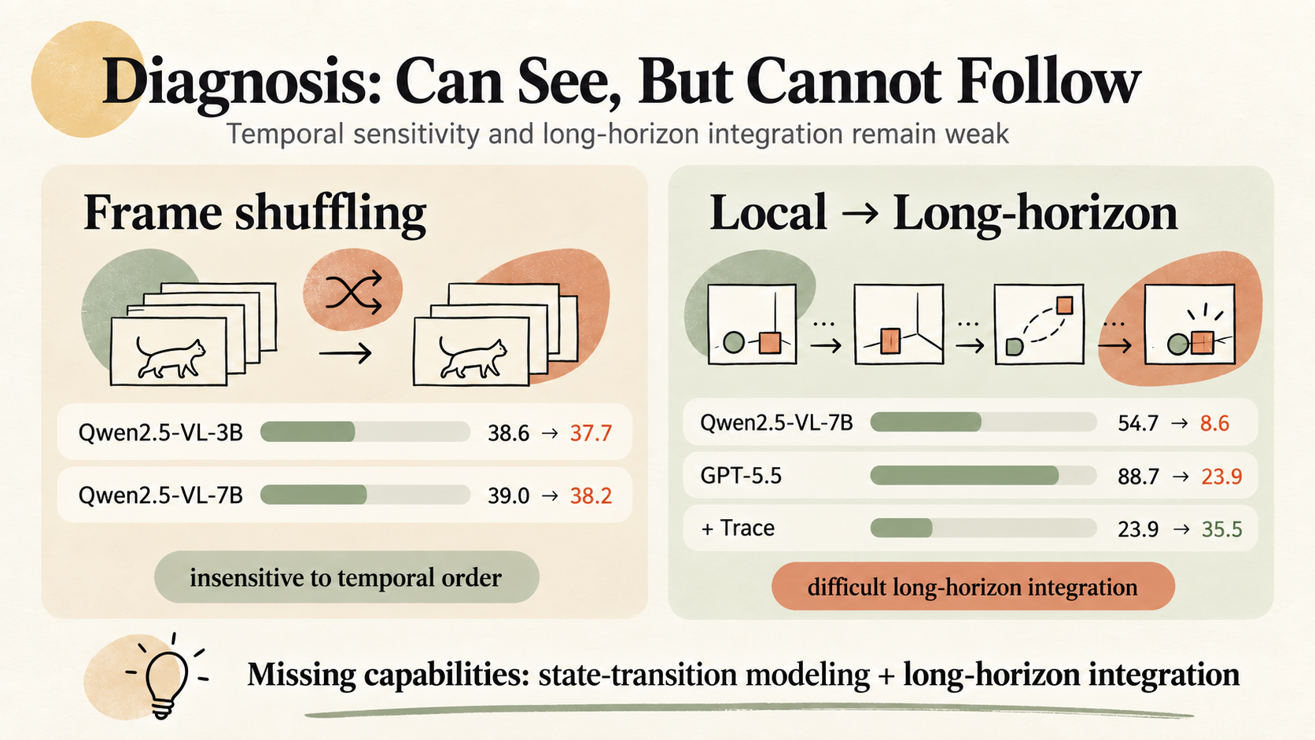
Notes:
Slide 03: State Transition Diagnostics

Slide 4
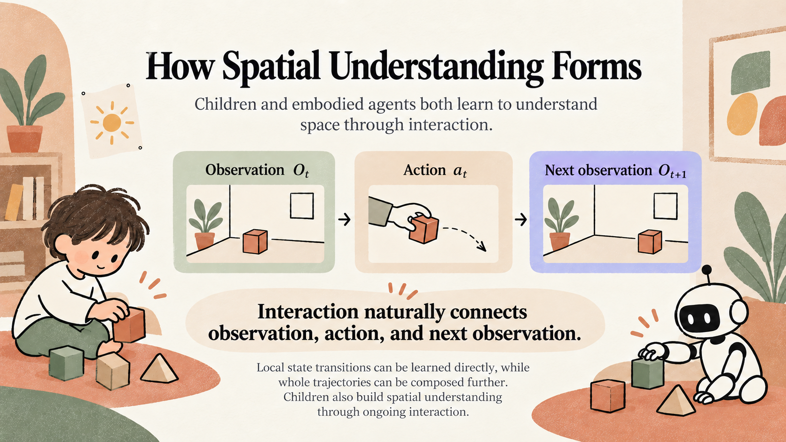
Notes:
Slide 04: How Spatial Understanding Forms
English version of the user-approved replacement page.

Slide 5
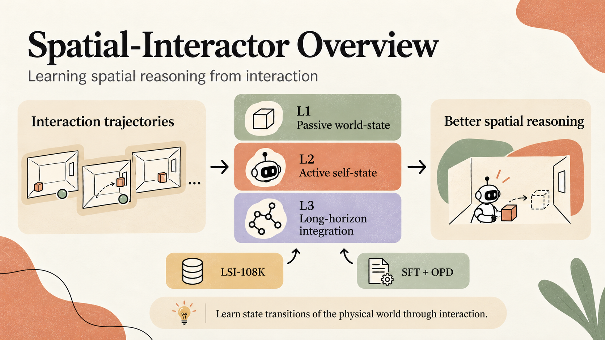
Notes:
Slide 05: Framework Overview

Slide 6
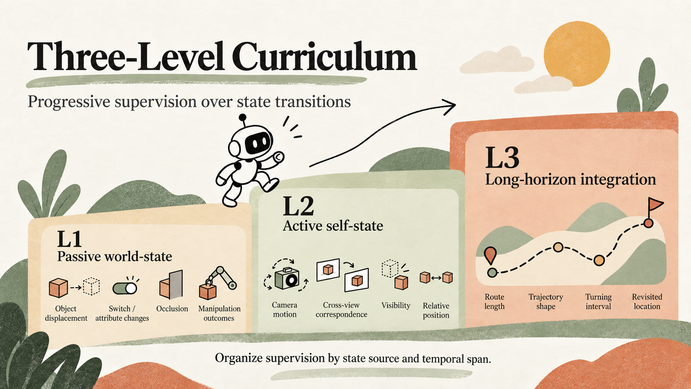
Notes:
Slide 06: Three Level Curriculum

Slide 7
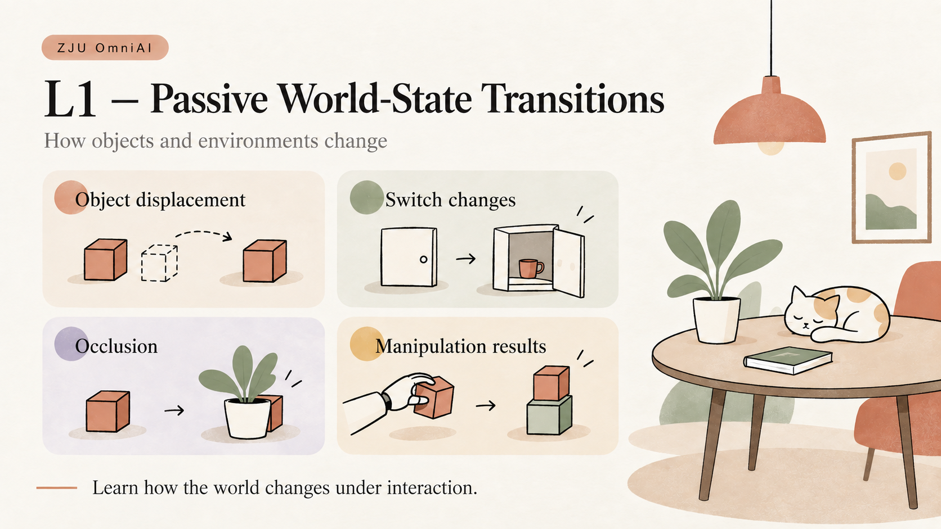
Notes:
Slide 07: L1 Passive World State Transitions

Slide 8
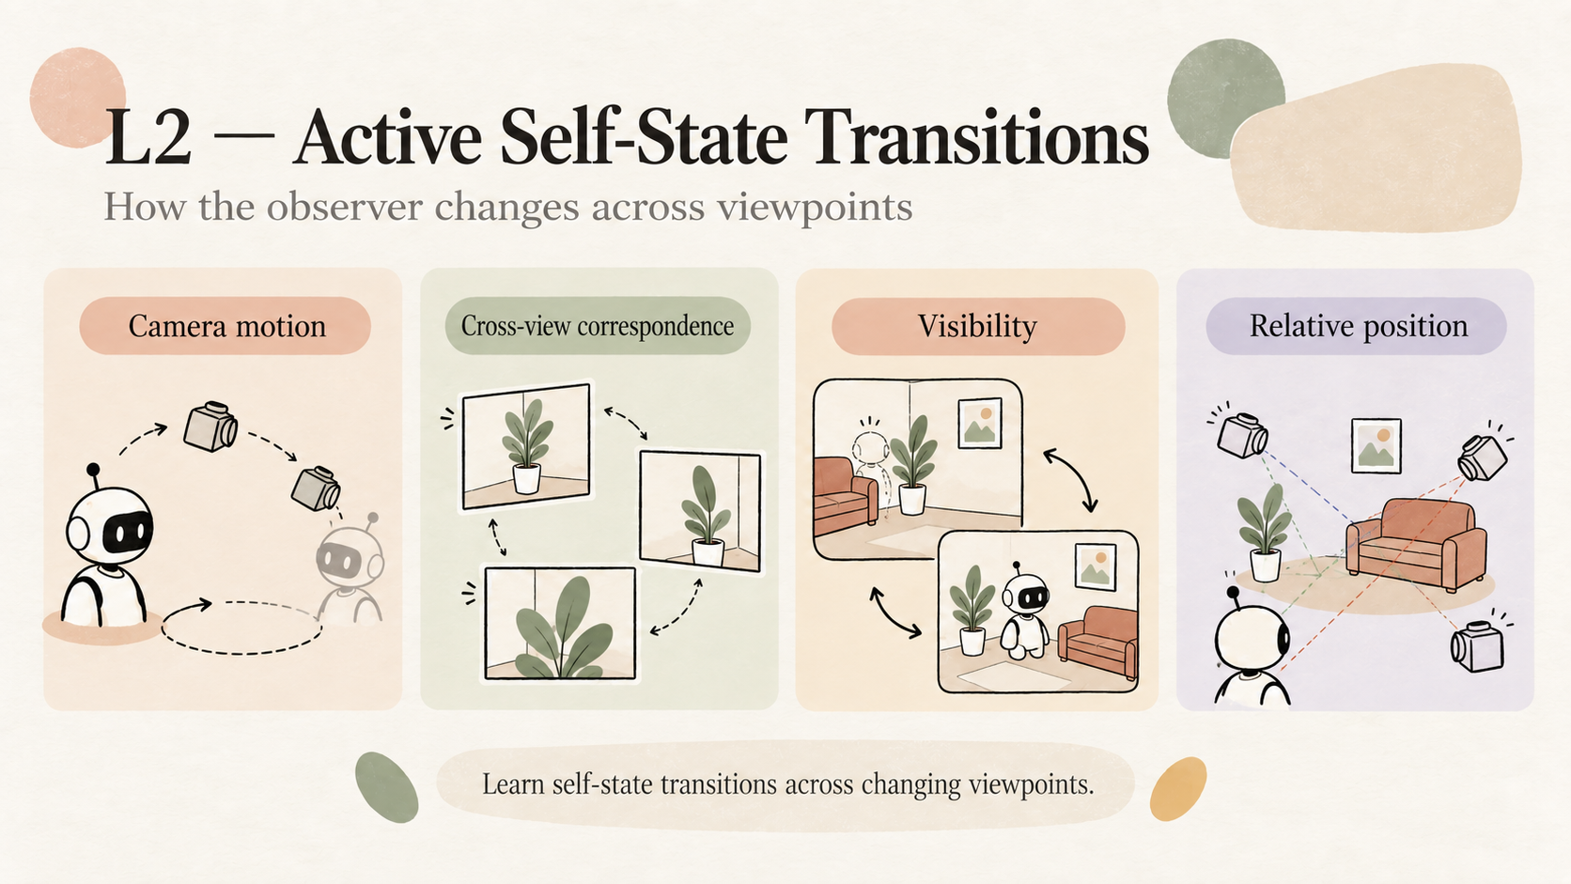
Notes:
Slide 08: L2 Active Self State Transitions

Slide 9
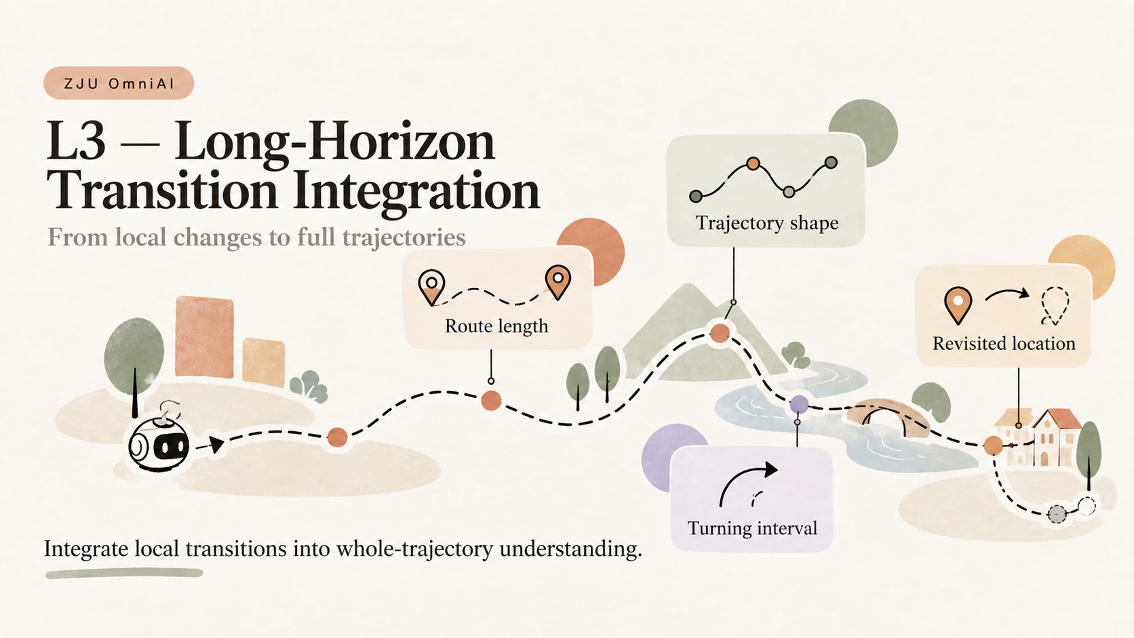
Notes:
Slide 09: L3 Long Horizon Transition Integration

Slide 10
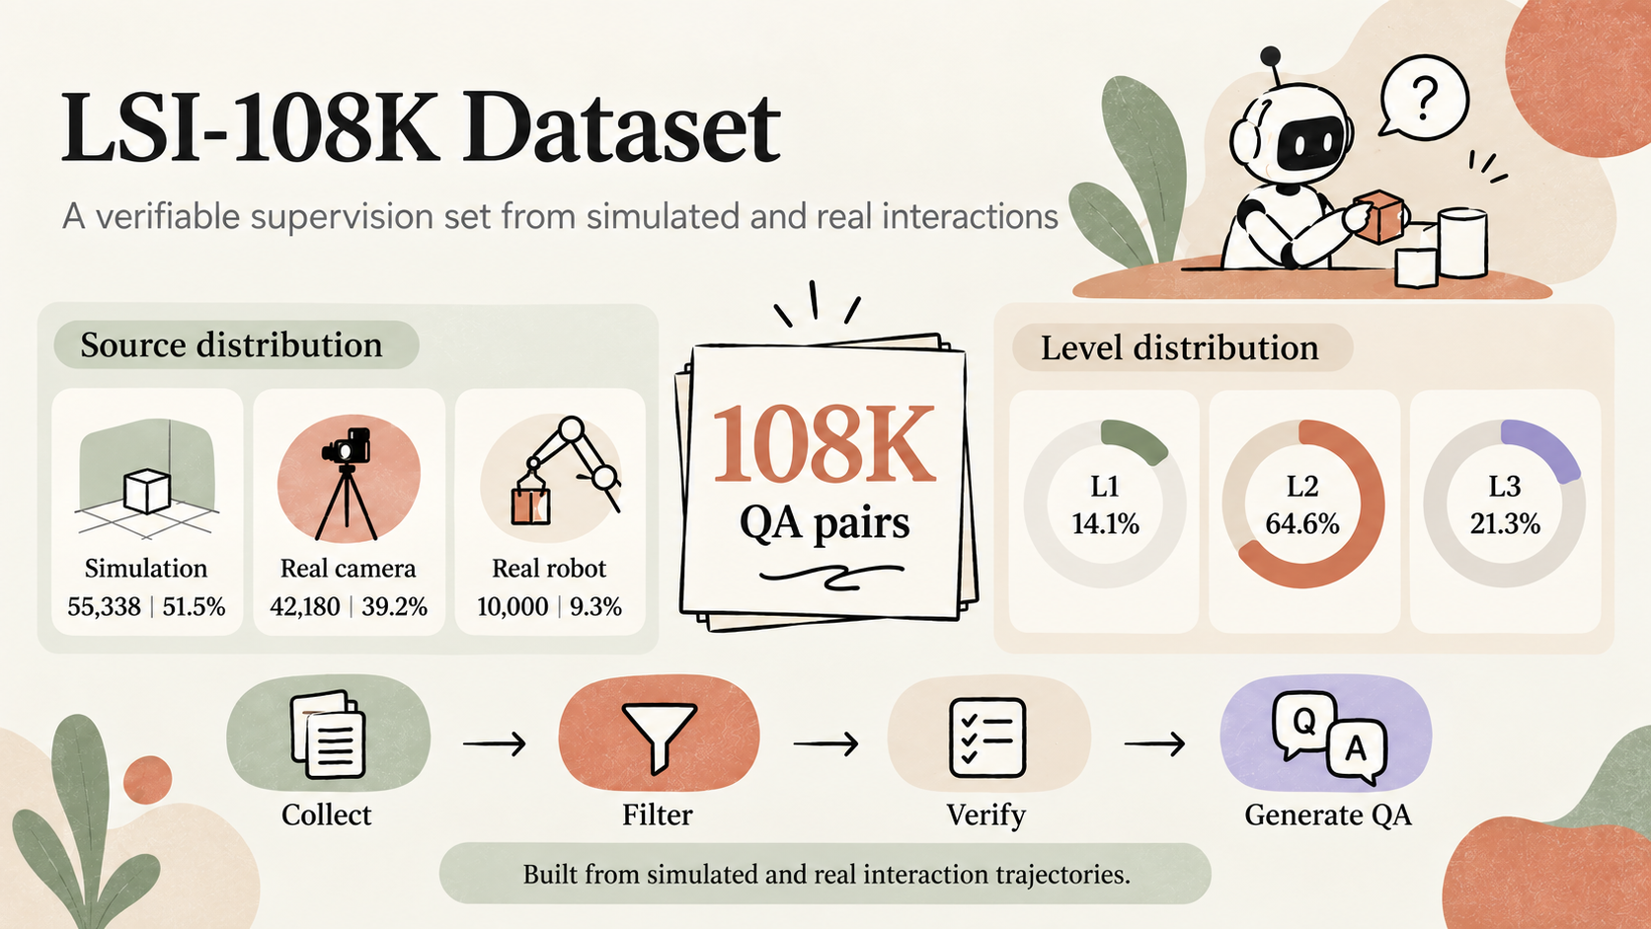
Notes:
Slide 10: LSI 108K Dataset

Slide 11
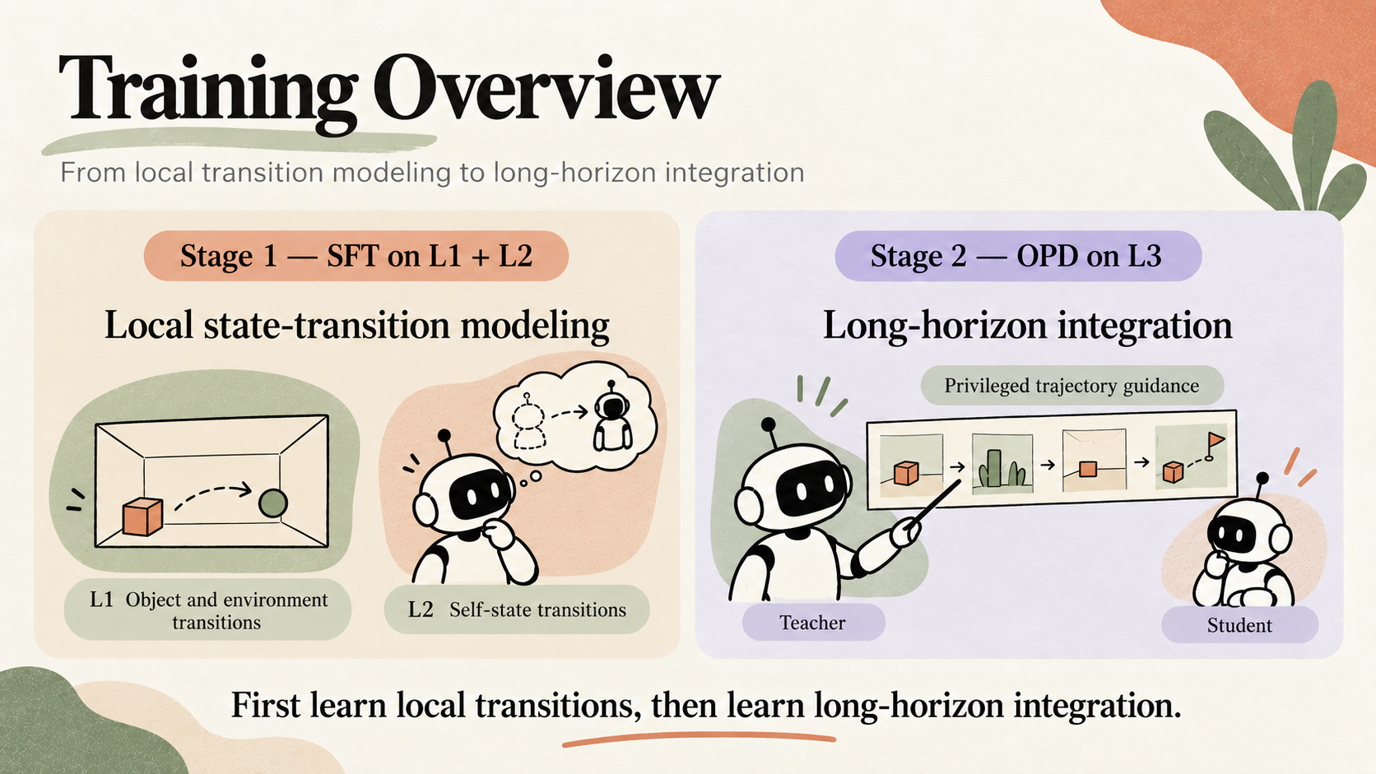
Notes:
Slide 11: Training Overview

Slide 12
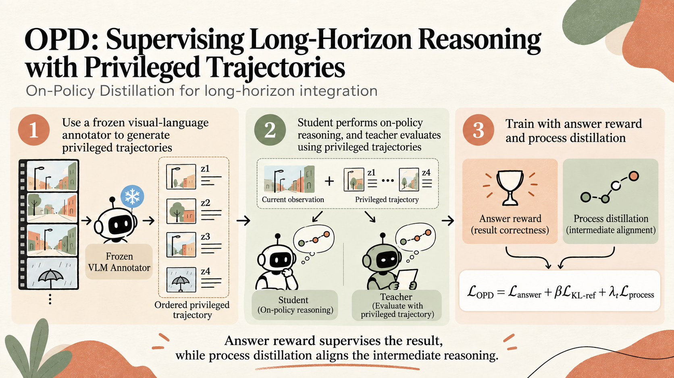
Notes:
Slide 12: On Policy Distillation

Slide 13
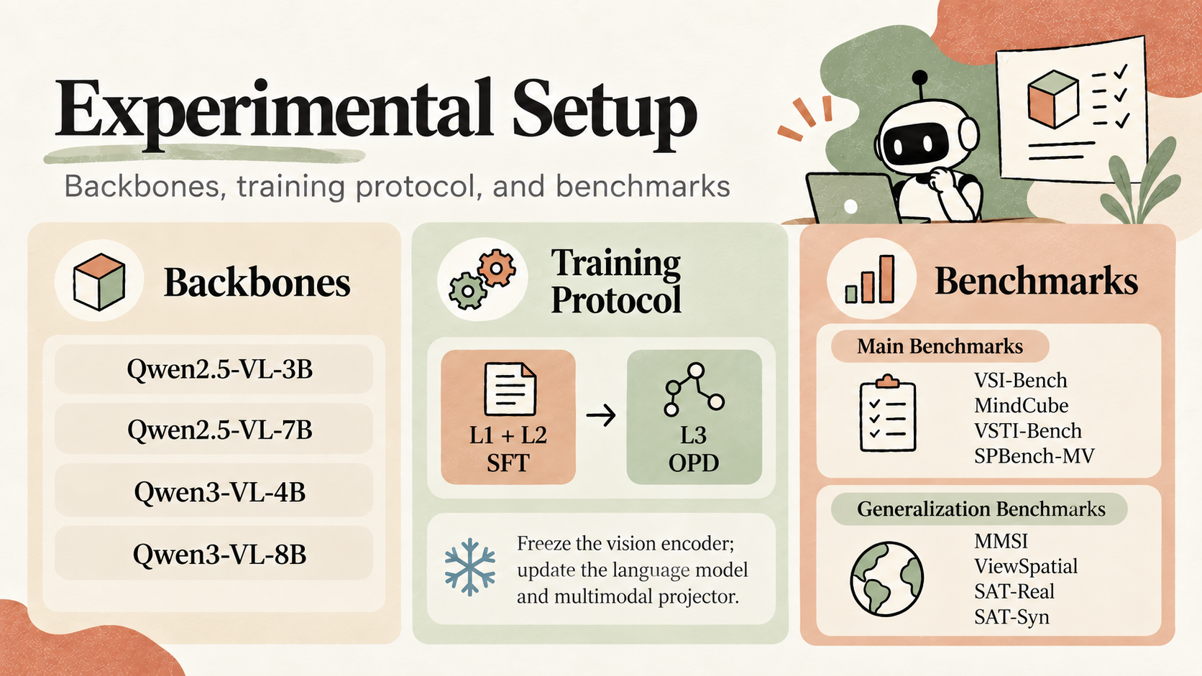
Notes:
Slide 13: Experimental Setup

Slide 14
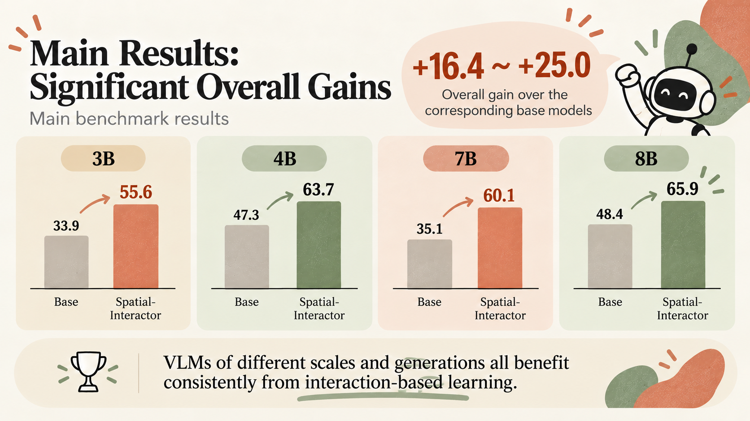
Notes:
Slide 14: Main Results

Slide 15
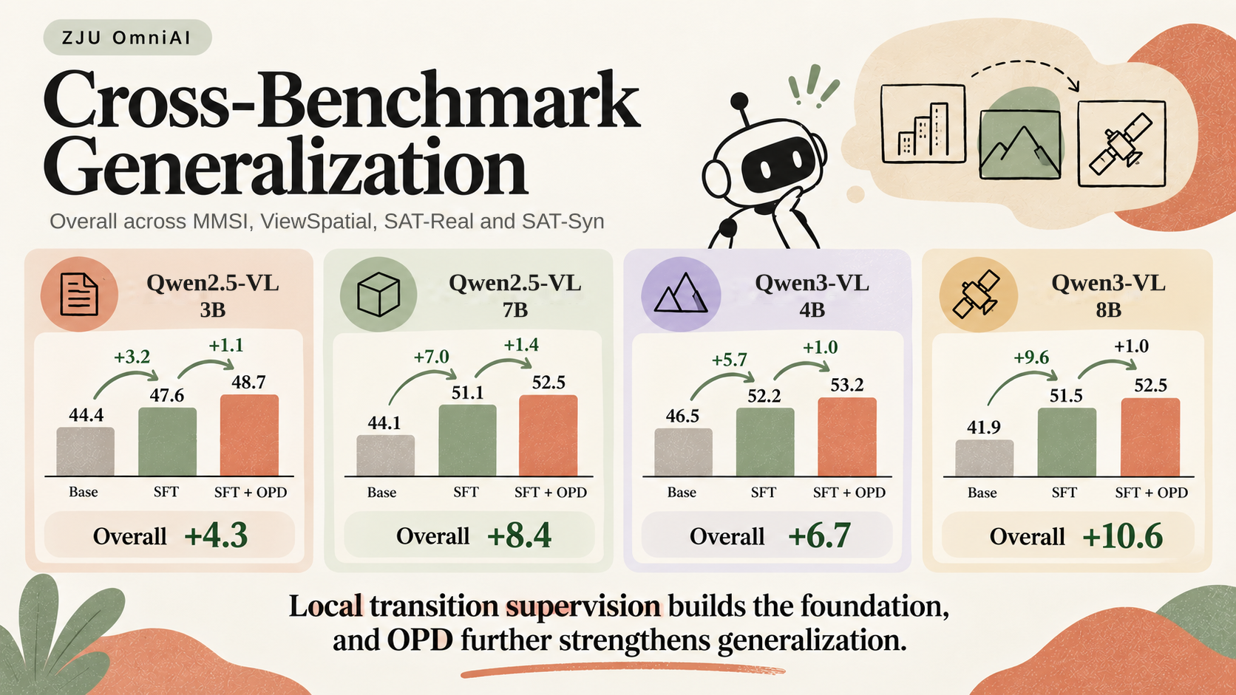
Notes:
Slide 15: Cross Benchmark Generalization
Source: supplied Spatial-Interactor manuscript, Table 2.
The four cards show per-backbone Overall across MMSI, ViewSpatial, SAT-Real and SAT-Syn.
Qwen2.5-VL-3B: 44.4 / 47.6 / 48.7.
Qwen2.5-VL-7B: 44.1 / 51.1 / 52.5.
Qwen3-VL-4B: 46.5 / 52.2 / 53.2.
Qwen3-VL-8B: 41.9 / 51.5 / 52.5.
Only the former mislabeled headings and the subtitle were corrected; numeric charts are unchanged.

Slide 16
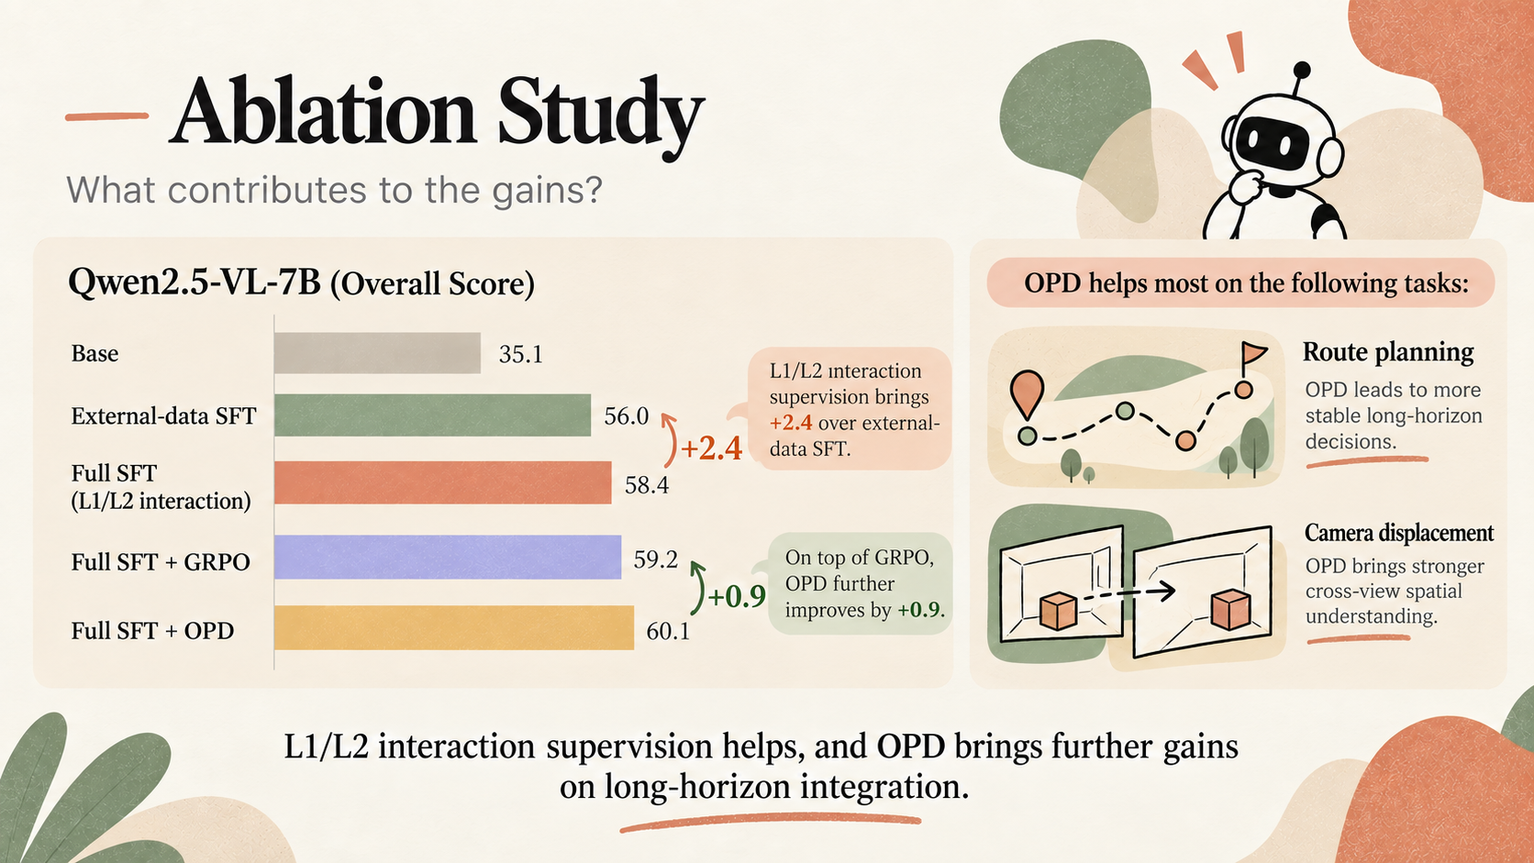
Notes:
Slide 16: Ablation Study

Slide 17
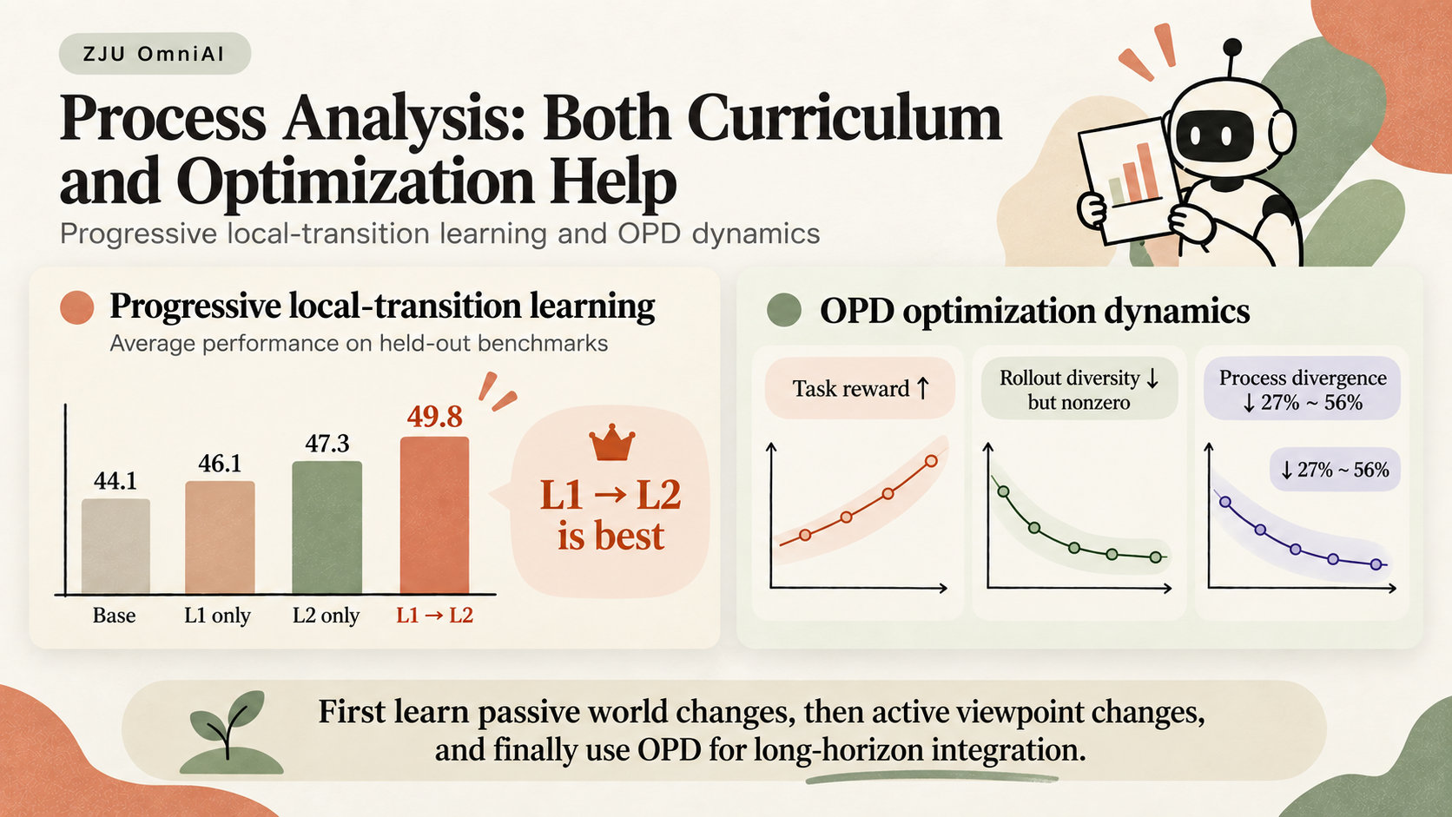
Notes:
Slide 17: Process Analysis

Slide 18
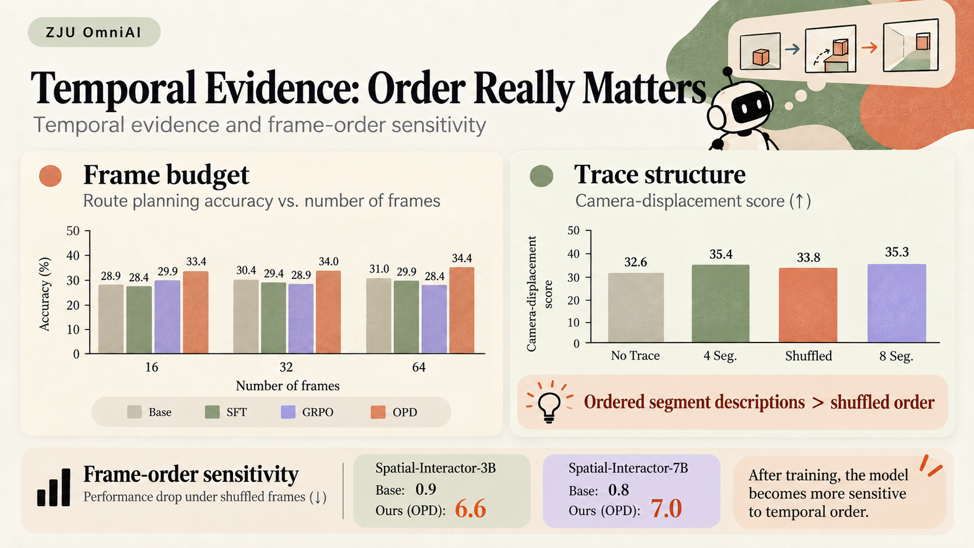
Notes:
Slide 18: Temporal Evidence Corrected
Frame-budget chart corrected to the latest image supplied by the user.
Columns: Frames | Base | SFT | GRPO | OPD. Accuracy (%); y-axis 0–50.
16 | 28.9 | 28.4 | 29.9 | 33.4
32 | 30.4 | 29.4 | 28.9 | 34.0
64 | 31.0 | 29.9 | 28.4 | 34.4
Trace-structure values and bottom frame-order sensitivity panel are unchanged.

Slide 19
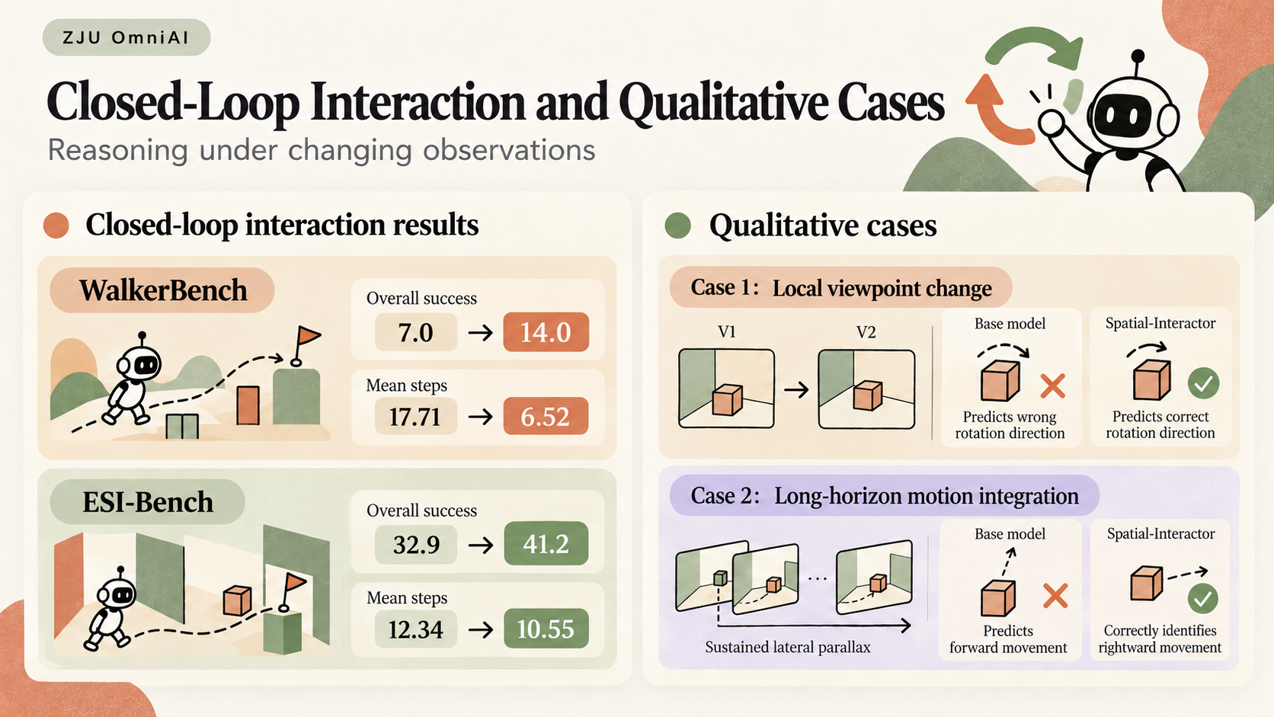
Notes:
Slide 19: Closed Loop Interaction and Qualitative Cases

Slide 20
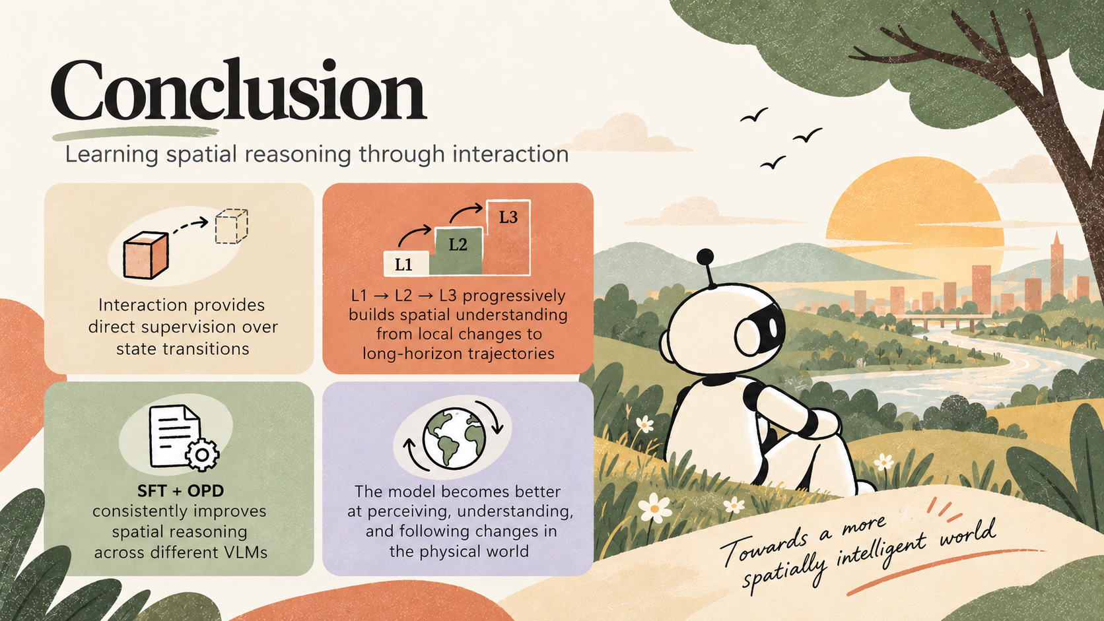
Notes:
Slide 20: Conclusion

