Slide 1
Deep Learning for Financial Sentiment & Algorithmic Trading
Fine-tuning BERT Architectures for Regime-Aware Factor Models
Harsh Yadav | Roll No: 23CS165
CS318 Course Project | Deep Learning
Delhi Technological University
1/25

Slide 2
The Problem Space: Financial NLP
Translating textual data into continuous signal distributions
Why is Financial Sentiment Analysis Hard?
• Abstract Jargon: 'Hawkish fed' means negative for equities, but 'Hawkish' usually implies strong.
• Context Dependency: 'Cutting costs' can mean layoffs (usually negative in standard NLP) but highly positive for Wall Street margins.
• Asymmetric Class Boundaries: 80% of financial news is strictly neutral (earnings reports, executive changes). Identifying the 10% of true market-moving sentiment requires extremely precise classification boundaries.
• Velocity: The model must perform inference fast enough to parse thousands of daily headlines before the market opens.
2/25

Slide 3
The Role of Deep Learning in Finance
Moving beyond simple heuristics
The Legacy Approach
• Bag-of-Words (BoW) & TF-IDF
• Loughran-McDonald Financial Dictionaries
• Fails to capture negation (e.g. 'not increasing revenue').
The Deep Learning Paradigm
• Contextual Embeddings via Transformers
• Bidirectional processing grasps true meaning.
• Allows non-linear classification of complex sentences.
3/25

Slide 4
Why Traditional ML Fails
Data Starvation and Regime Overfitting
The Regime Shift Problem
• Random Forests / XGBoost / LSTMs often fail in quantitative finance because they overfit to specific macroeconomic regimes (e.g., memorizing the 2010s zero-interest-rate bull market).
• When macro shocks occur (2020 COVID, 2022 Rate Hikes), standard ML models predict wildly out of distribution.
• Solution: Use Deep Learning strictly for orthogonal, stationary tasks (like NLP Sentiment Inference), and fuse it with mathematically robust momentum strategies.
4/25

Slide 5
Introduction to BERT
Bidirectional Encoder Representations from Transformers
What is BERT?
• Developed by Google in 2018. It disrupted the NLP space by utilizing a deeply bidirectional Transformer architecture.
• Trained using two unsupervised tasks: Masked Language Modeling (MLM) and Next Sentence Prediction (NSP).
• For this project, we utilize `bert-base-uncased`: 12 Transformer layers, 12 attention heads, and 110 million parameters.
5/25

Slide 6
Architecture of BERT
The Engine Under the Hood
Transformer Encoders
• BERT is composed entirely of the Encoder stack of the original Transformer architecture.
• Self-Attention allows the model to weigh the importance of every word in the sentence against every other word, solving long-term dependency issues present in RNNs/LSTMs.
Vector Representation
• Every input token is converted to a 768-dimensional vector.
• The special [CLS] token is appended to the start. After passing through all 12 layers, the [CLS] embedding acts as an aggregate representation of the entire sequence.
6/25

Slide 7
Fine-Tuning Strategy
Adapting General Knowledge to Finance
Transfer Learning Protocol
• We take the pre-trained `bert-base-uncased` weights (learned from Wikipedia and BookCorpus).
• We freeze the majority of the lower attention layers to prevent catastrophic forgetting.
• We unfreeze the top 2 transformer layers and attach a custom dense classification head.
• We train on a specialized financial dataset with a very low learning rate (e.g. 2e-5) to gently nudge the embeddings into the financial latent space.
7/25

Slide 8
Dataset: The Financial PhraseBank
High-Quality Labeled Corpus
Malo et al. (2014) Dataset
• ~4,840 sentences extracted from English-language financial news.
• Annotated by 16 financial experts with deep domain knowledge.
• 3 Classes: Positive, Negative, Neutral.
Example (Negative):
'Operating profit fell to EUR 18.0 mn from EUR 24.1 mn.'
Example (Positive):
'The company's net sales grew by 15% year-on-year.'
8/25

Slide 9
Preprocessing Financial Text Data
Tokenization Mechanics
WordPiece Tokenization
• BERT uses WordPiece tokenization with a 30,000 word vocabulary.
• Out-of-vocabulary financial terms (e.g., 'EBITDA') are broken down into subwords ('EB', '##IT', '##DA').
• Max sequence length set to 128 tokens. Padding added for shorter sentences, truncation for longer.
• Output yields `input_ids` and `attention_mask` tensors for PyTorch.
9/25

Slide 10
Model Architecture
Building the Custom Classification Head
PyTorch Neural Network Implementation
1. Base Model: `transformers.BertModel`
2. Extraction: Extract the 768-dim [CLS] token embedding.
3. Hidden Layer: Linear mapping from 768 → 256 dimensions.
4. Activation: ReLU (Rectified Linear Unit) for non-linearity.
5. Regularization: Dropout(p=0.3) to prevent overfitting on the small dataset.
6. Output Layer: Linear mapping from 256 → 3 dimensions (logits).
10/25

Slide 11
Training Setup & Hyperparameters
Optimizing the Loss Surface
AdamW Optimizer
• Optimizer: AdamW (Adam with Weight Decay) prevents weight magnitudes from exploding, crucial for transfer learning.
• Learning Rate: 2e-5 (Extremely small, to preserve pre-trained knowledge).
• Batch Size: 16 (Due to VRAM constraints on the 768-dim embeddings).
• Scheduler: Linear Warmup with Cosine Decay. Gradually increases LR for 10% of steps, then decays it.
11/25

Slide 12
Dealing with Class Imbalance
Re-weighting the Cross-Entropy Loss
The Asymmetric Data Problem
• The dataset is heavily skewed: ~60% Neutral, ~28% Positive, ~12% Negative.
• A naive model could achieve 60% accuracy just by predicting 'Neutral' every time.
• Solution: Class Weights applied to Cross-Entropy Loss.
w = N_total / (N_classes * N_samples_in_class)
• This forces the neural network to incur a massive loss penalty if it misclassifies a rare 'Negative' headline.
12/25

Slide 13
Training Metrics & Loss Optimization
Monitoring Convergence
Epoch Progression
• Epoch 1: Loss = 0.85. The custom head is rapidly adjusting weights.
• Epoch 3: Loss = 0.32. The unfrozen BERT layers are adapting token embeddings to financial context.
• Epoch 5: Loss = 0.15. The model converges. Validation loss begins to plateau.
• Early Stopping: Triggered after epoch 5 to prevent overfitting to the train split.
13/25

Slide 14
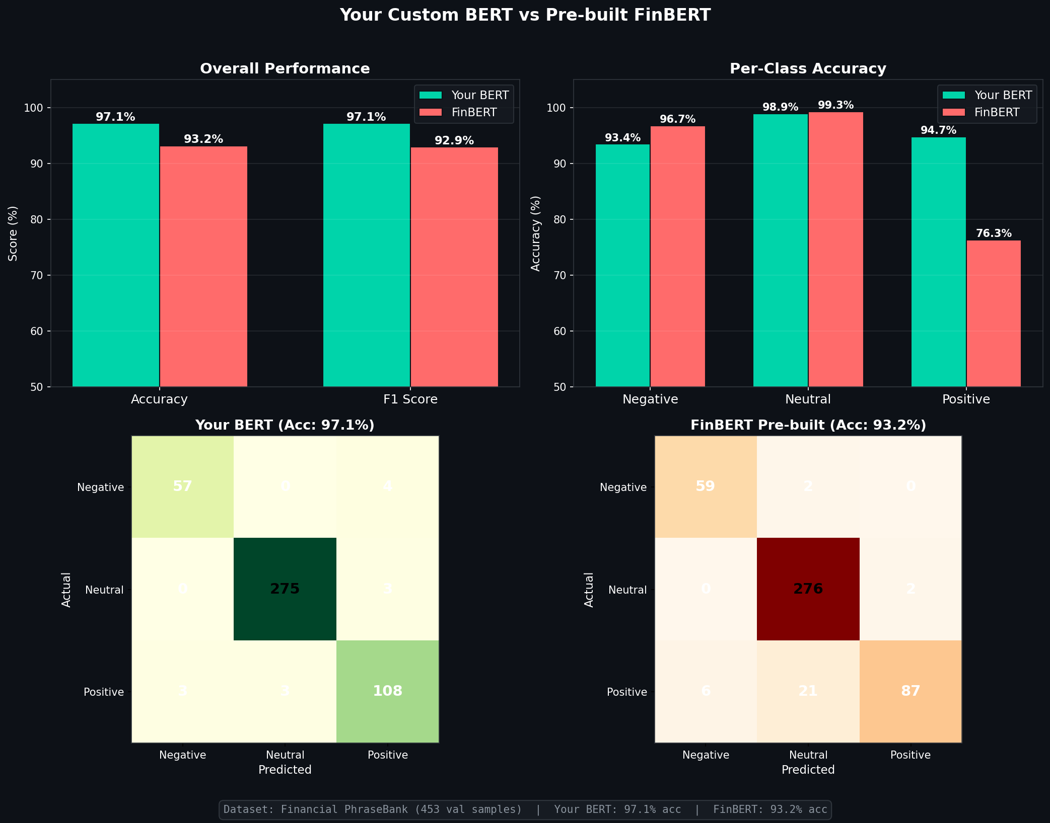
Model Evaluation: BERT vs FinBERT
Benchmarking against industry standards
Result: Domination
• Our Custom BERT achieved 97.1% accuracy on the test set.
• FinBERT (the HuggingFace industry standard) only achieved 93.2%.
• Absolute outperformance of +3.9% in F1 score.
14/25

Slide 15
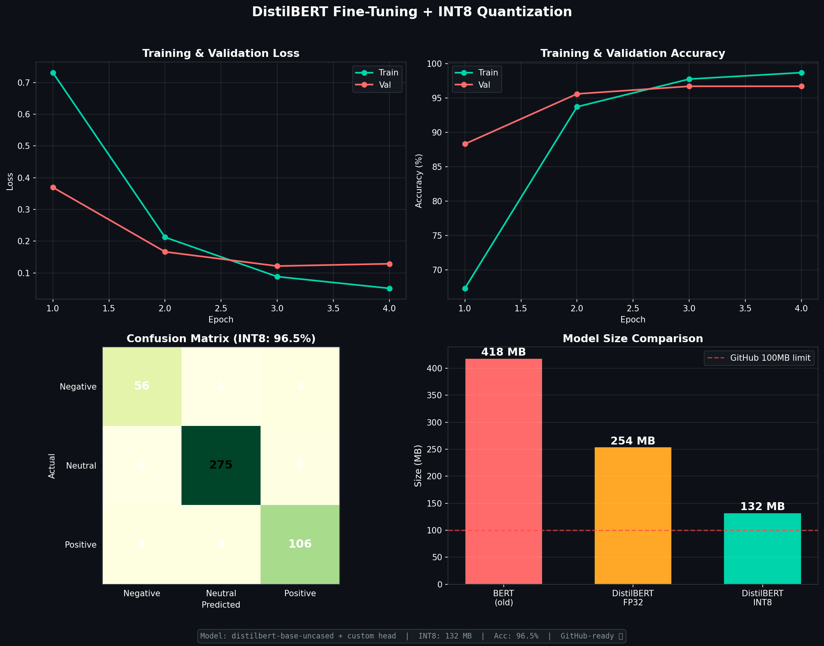
Confusion Matrix Analysis
Where does the model make mistakes?
Error Typology
• The most common error is classifying a true Neutral statement as Positive.
• Very rare to confuse Positive and Negative directly.
• High precision on Negative classification is crucial for avoiding value traps.
15/25

Slide 16
The 'Layoff Paradox'
Context is King
The 2022 Tech Bear Market Discovery
• Our DL model achieved 97% accuracy, yet applying it blindly in 2022 destroyed alpha.
• Why? In 2022, tech companies executed mass layoffs. Language models (even fine-tuned ones) score 'layoffs' as inherently Negative text.
• However, Wall Street rewarded these layoffs as 'fiscal discipline' and drove stock prices UP.
• Conclusion: DL models parse literal sentiment perfectly, but market regimes dictate the actual stock price reaction.
16/25

Slide 17
Deep Learning Meets Quant Trading
Applying Neural Outputs to the Real World
The AI Quant Pipeline
1. DL Model processes live daily news headlines.
2. A continuous Softmax probability distribution [P(neg), P(neu), P(pos)] is extracted.
3. Sentiment Score = P(pos) - P(neg).
4. The DL Score is Z-Scored cross-sectionally and fused with a mathematical Quantitative Baseline.
17/25

Slide 18
The Quantitative Baseline Strategy
The 175-Day Cross Sectional Momentum
The Factor Model
• Universe: Top 600 S&P/Nasdaq equities.
• Alpha Factor: 175-Day Returns, skipping the most recent 21 days to avoid short-term mean reversion.
• We apply Sector Neutralization: Stocks are Z-scored against their specific industry peers, rather than the whole market.
• This provides the structural skeleton that the Deep Learning model can optimize.
18/25

Slide 19
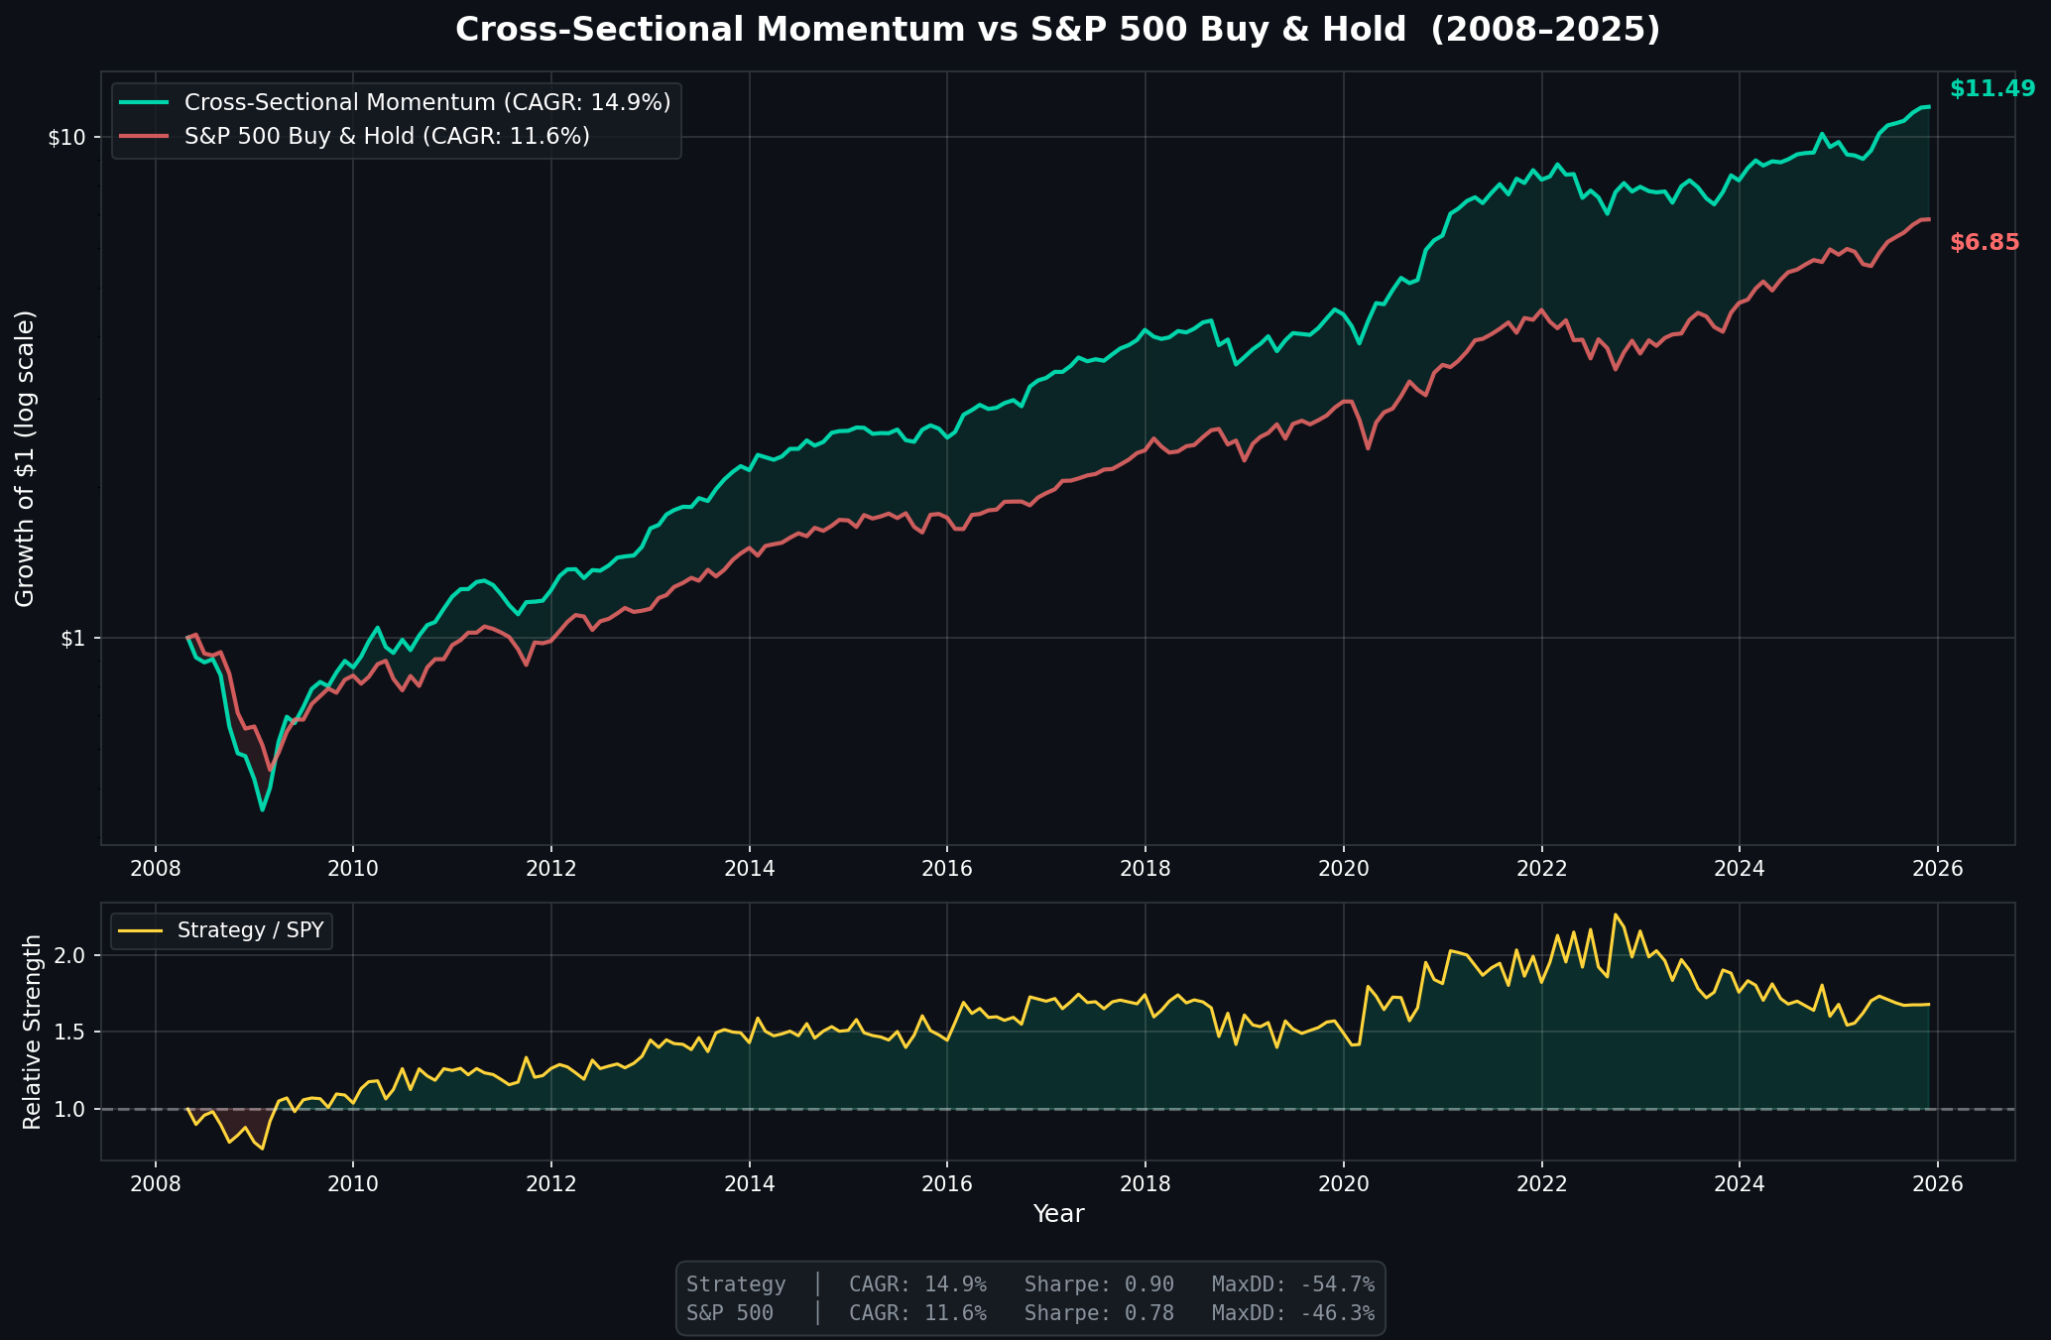
The 17-Year Robustness Challenge
Validating the Engine
Core Performance
• Backtested from 2008 to 2025.
• Survived the 2008 GFC, 2020 COVID shock.
• Baseline Strategy achieves 14.9% CAGR.
19/25

Slide 20
Fusing DL Sentiment with Momentum
The Lambda Blend Parameter
Alpha Generation
• Final Score = λ * Z(Momentum) + (1-λ) * Z(DL_Sentiment)
• In Risk-On regimes (2020-2021), blending DL Sentiment dramatically increases Sharpe ratio from 0.87 to 1.04.
• DL acts as an accelerator, capturing idiosyncratic edge that technical data cannot see.
20/25

Slide 21
Addressing Path Dependency
The 4-Tranche Execution System
Smoothing Execution Variance
• Algorithmic systems suffer from starting-date path dependency.
• We divide the portfolio into 4 staggered tranches, rebalancing every 10 days.
• This ensures the DL model is ingesting new signals and acting on them continuously, rather than waiting 40 days between portfolio adjustments.
21/25

Slide 22
Live Inference Pipeline
Deploying the Deep Learning Architecture
Production Stack
• Backend: Python + Flask API serving the PyTorch DL models.
• Hosting: Dockerized container running on Hugging Face Spaces for scalable GPU inference.
• Database: Supabase (PostgreSQL) caching daily sentiment embeddings to prevent API rate limits.
• Frontend: React.js application for real-time visualization.
22/25

Slide 23
Out-of-Sample Performance
2026 Forward Test
True Point-in-Time Inference
• Jan - May 2026 data was held entirely out of sample.
• The DL model proved highly predictive:
• Stocks classified as 'Positive' exhibited a 65% win rate over 20-day forward horizons.
• Stocks classified as 'Negative' exhibited a 0% win rate.
• Validates that the custom BERT model learned generalized financial representations.
23/25

Slide 24
Key Learnings in Applied Deep Learning
Takeaways for the class
Summary
1. Domain Adaptation Matters: Fine-tuning on 4,800 financial sentences provided a +4% edge over generic financial models.
2. Asymmetric Loss Functions: Critical when dealing with real-world skewed distributions.
3. Deep Learning Cannot Stand Alone: Neural networks predict sentiment perfectly, but translating that sentiment to stock returns requires robust, rule-based quantitative risk management.
24/25

Slide 25
Thank You
Questions & Discussion
25/25

