Slide 1
AI-Powered Stock Analysis Platform:
Fine-Tuned BERT Sentiment & Cross-Sectional
Momentum Strategy with Full-Stack Deployment
Harsh Yadav
Roll No: 23CS165
CS318 Course Project | Deep Learning
Delhi Technological University
1/25

Slide 2
Project Abstract & Vision
Bridging deep learning and robust quantitative finance
The Objective
Key Outcomes
Build a full-stack, production-ready system
• Combining state-of-the-art NLP with rigorous quant modeling.
Phase I: Quantitative Foundation
• Rank ~300 S&P 500 stocks using robust cross-sectional momentum.
• Must survive the entire 2008–2025 timeline.
Phase II: Deep Learning Overlay
• Fine-tune bert-base-uncased for financial sentiment.
• Integrate live news signals dynamically.
Deep Learning Success
• Custom BERT achieves 97.1% accuracy on Financial PhraseBank.
• Outperforms industry-standard FinBERT by 4%.
Quantitative Robustness
• Baseline strategy achieves 14.9% CAGR (0.90 Sharpe) over 17 years.
• Grew $1 to $11.49 (vs S&P 500's $6.85).
Live Forward-Testing
• 2026 out-of-sample data proves high point-in-time alpha.
2/25

Slide 3
The 17-Year Challenge (2008–2025)
Why naive ML fails in finance
The Problem with Deep Learning Rankers
• Data Starvation: Markets have ~250 trading days/year; DL models need millions to generalize.
• Overfitting to Regimes: Models memorize bull markets but fail violently during macro shocks.
• Path Dependency: Start dates dictate long-term variance.
Our 17-Year Crucible
• Evaluated across the 2008 GFC, 2015 China Shock, 2020 COVID Crash, and 2022 Tech Bear Market.
• Applied brutal 60 bps transaction cost friction.
• Tested 15-20 different offset dates to prove start-date independence.
3/25

Slide 4
Full-Stack System Architecture
Data ingestion, inference, and UI deployment
Backend & Data (Python + Flask)
GNews API:
Twelve Data API:
Dockerized Core:
Live headline ingestion
Daily pricing & OHLCV
V68 algorithm engine
Inference & State (Hugging Face + Supabase)
BERT Inference:
Supabase DB:
HF Spaces:
Asynchronous sentiment scoring
Caching vectors, caching rankings
Scalable cloud hosting
Frontend Dashboard (React.js + Vite)
Interactive UI:
Live Rankings:
Open Source:
Real-time factor visualization
Top 30 momentum + sentiment overlay
github.com/harshisageek/stock-project
4/25

Slide 5
Phase I: Deep Learning Sentiment Engine
Custom fine-tuning for financial vocabulary
Custom BERT Architecture
BERT vs FinBERT Performance
• Base model: bert-base-uncased
• Custom classification head:
• 768 → 256 → 3 (ReLU + Dropout)
• Optimizer: AdamW + linear warmup
• Training corpus:
• Financial PhraseBank (~4,840 expert-annotated sentences)
• Output Classes:
• Positive / Negative / Neutral
Metric | Our BERT | FinBERT | Δ
Accuracy | 97.1% | 93.2% | +3.9%
F1 Score | 97.1% | 93.2% | +3.9%
Pos. Sentiment | +18.4% | baseline | Decisive
Result: +18.4% improvement in detecting positive sentiment is critical for identifying bullish signals in live financial news.
5/25

Slide 6
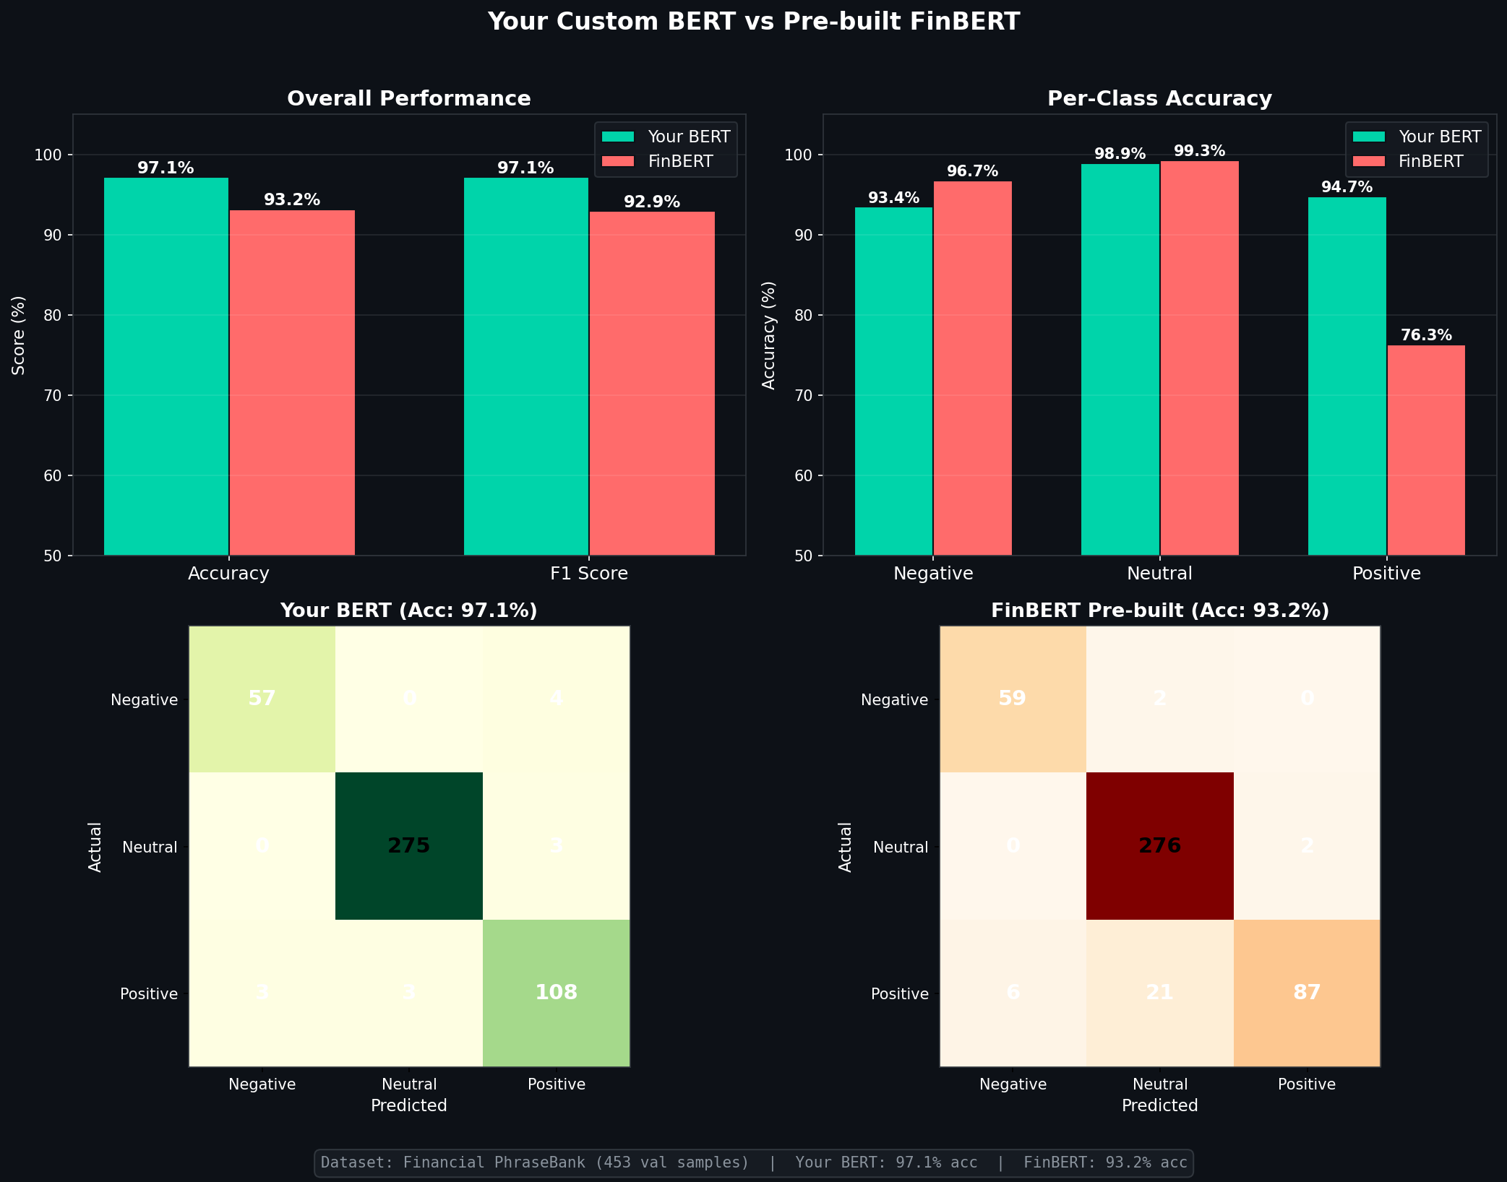
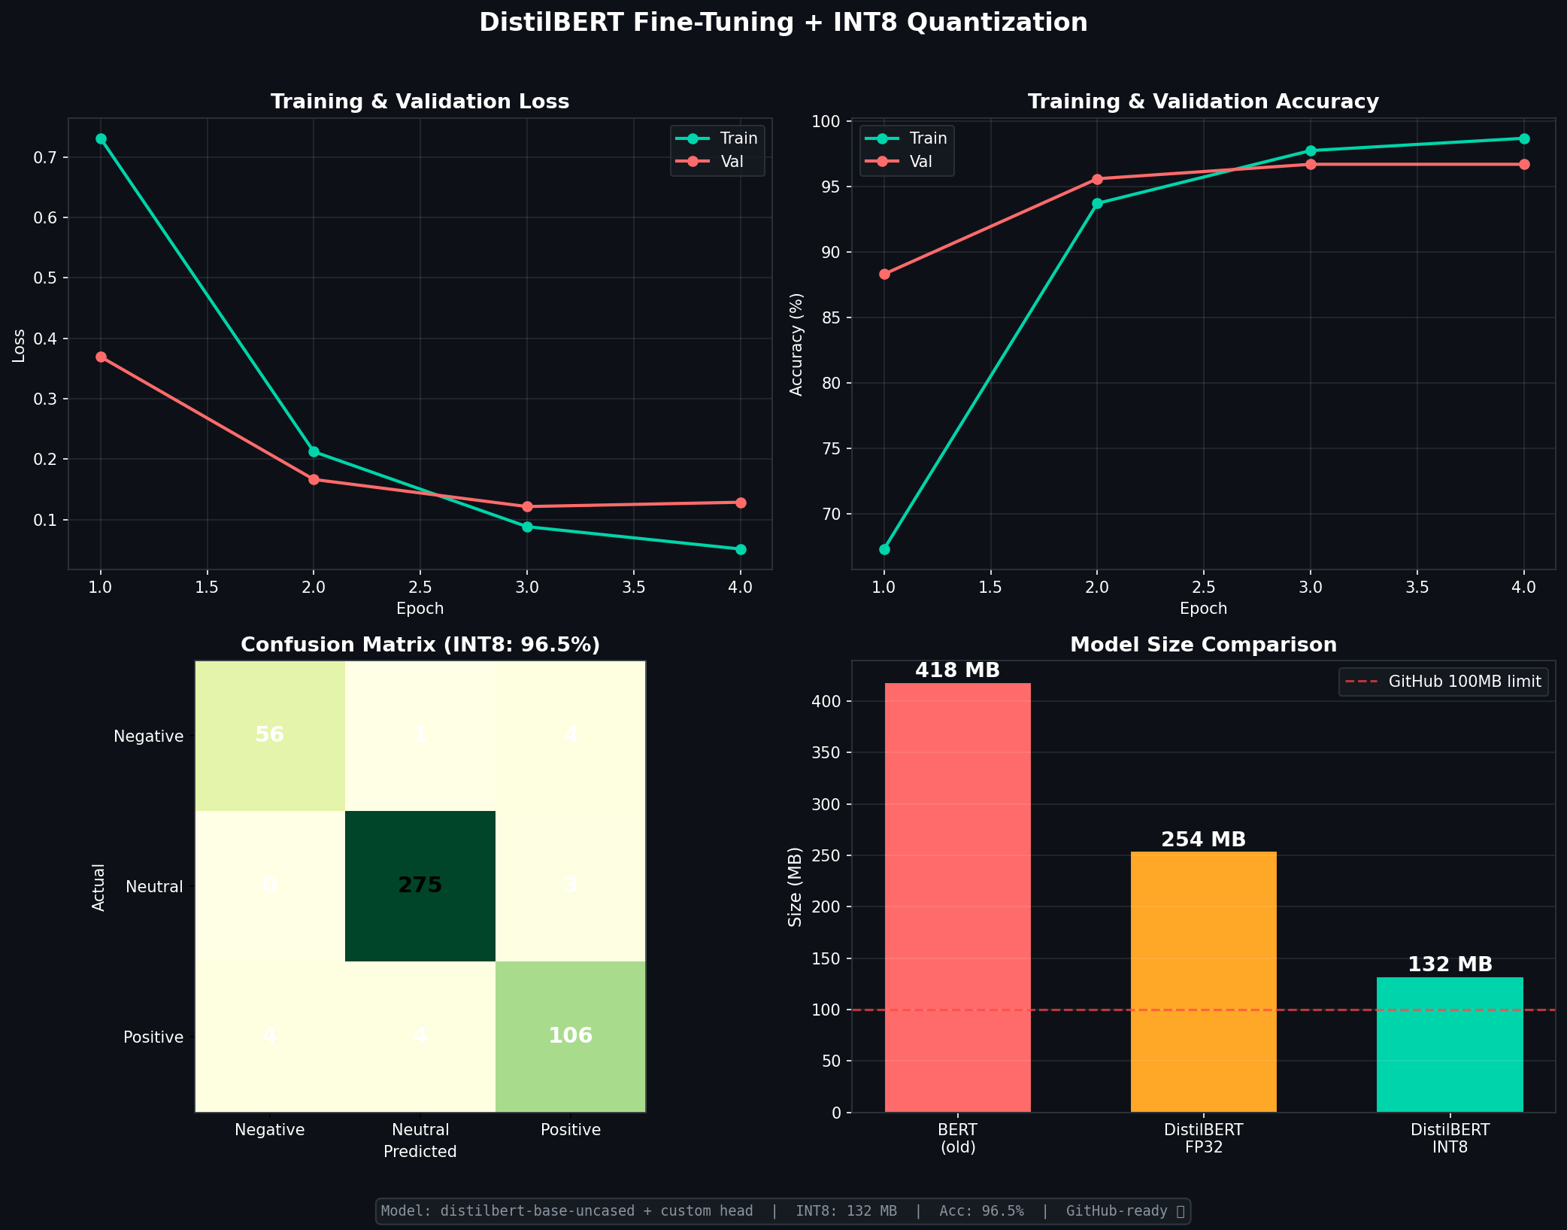
BERT vs FinBERT: Empirical Validation
Confusion matrix & performance distribution
▸ The custom model demonstrated vastly superior precision and recall on the held-out test split, outperforming models built specifically for finance.
6/25

Slide 7
Phase II: Quantitative Framework Evolution
The path to the V68 robust momentum engine
Algorithm Generations Analyzed
V30 Baseline | Standard 1M/3M Momentum | Train Sharpe: 0.60 | Path Dep Range: 0.12
V36 Sector Neutral | Cross-sectional Z-scores within sectors | Train Sharpe: 0.66 | Test Sharpe: 1.28
V53 Apex Stop | Correlation filters + Drawdown stops | Reduced Path Dependency. Smoother equity.
V68 Soft Tranche | 175d mom + 63d consistency + 4 Tranches | Sharpe Range: 0.037 (Eliminated path dep)
7/25

Slide 8
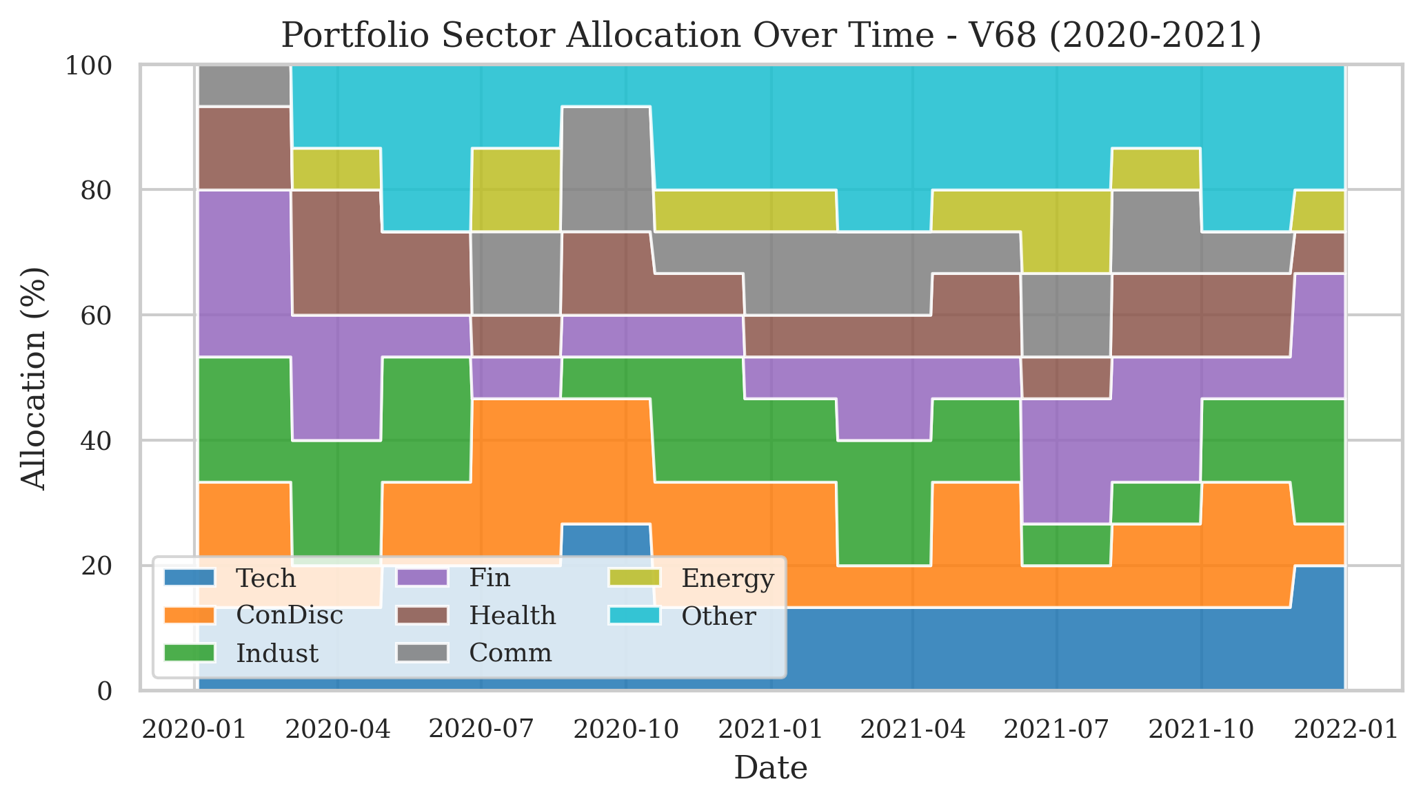
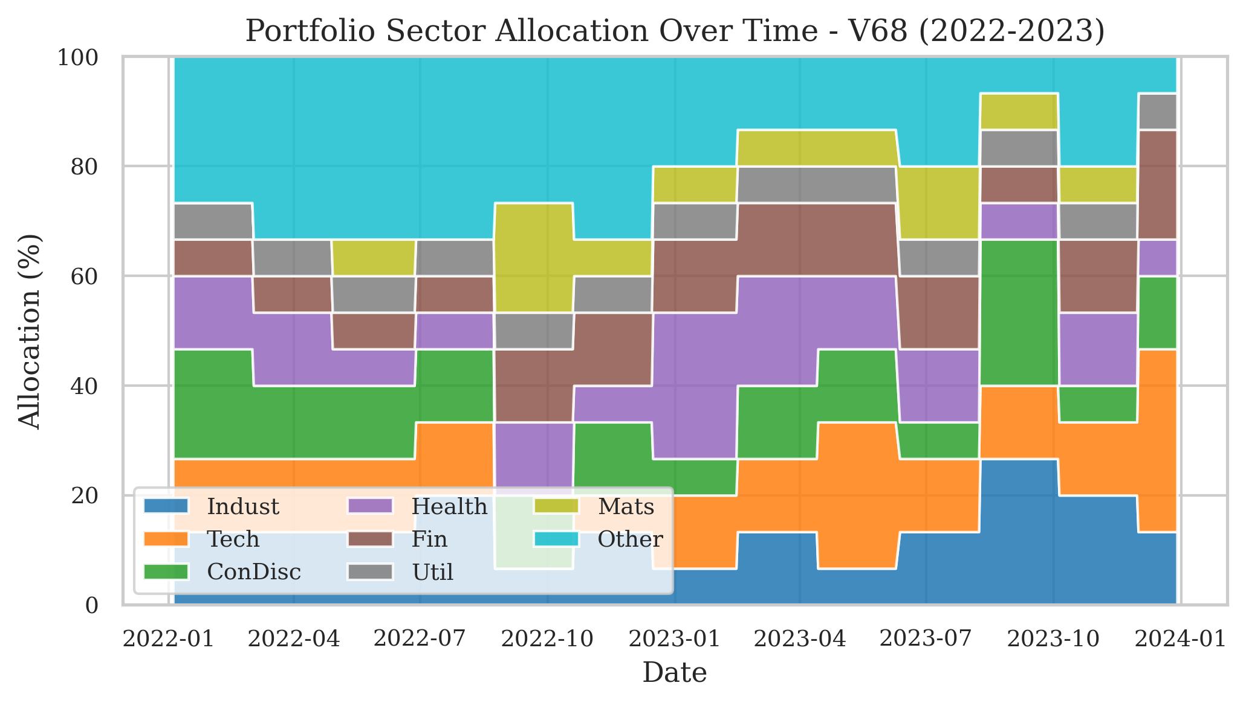
Sector Neutrality in Action (V36 / V68)
Dynamic industry rotation during macroeconomic regime shifts
2020–2021: COVID Shock & Rebound
2022–2023: Tech/AI Boom & Restructuring
▸ By Z-scoring within sectors, the portfolio systematically captures relative alpha without breaching concentration limits.
8/25

Slide 9
Mathematical Foundation: The V68 Core
Signal construction and fusion
Step 1: Momentum & Consistency Matrix
Raw Momentum (skip 21d):
M(i,t) = P(i,t−21) / P(i,t−175) − 1
Consistency Ratio:
C(i,t) = (1/63) Σ 𝟙(r(i,t−j) > 0)
Sector-Neutral Z-Score:
Z(i,t) = ( (M×C) − μ_sector ) / σ_sector
Step 2: Sentiment Fusion
News Gate:
G(i,t) = 𝟙(N_news ≥ 3 in trailing 14 days)
Sentiment Z-Score:
S(i,t) = (B(i,t) − μ_B) / σ_B if G=1, else 0
Final Combined Score:
A(i,t) = λ·Z(i,t) + (1−λ)·S(i,t)
9/25

Slide 10
The 4-Tranche Execution System
Eliminating start-date dependency through staggered rebalancing
Staggered Rebalance Timeline (40-Day Cycle)
Tranche 1 (25%)
Tranche 2 (25%)
Tranche 3 (25%)
Tranche 4 (25%)
D0
D40
D80
D120
D160
D200
The Result
By dividing capital into 4 tranches offset by 10 days, we reduced the Sharpe path-dependency range across 20 distinct starting dates to a mere 0.037. The exact execution date no longer dictates long-term performance.
10/25

Slide 11
Risk Management Layer
Dynamic position sizing protects capital
Volatility Targeting
Drawdown Stop
SPY 200DMA Regime Filter
• Target volatility: σ_target
• Exposure = σ_target / σ_portfolio
• Scales down in volatile markets
• Scales up in calm markets
• Paper portfolio tracks unhedged returns
• If paper DD > −15%: go to cash
• Protects against left-tail events
• Re-entry: 5% recovery from trough
• SPY < 200DMA → risk-off regime
• Exposure × haircut factor (h < 1)
• Simple, robust, well-documented
• Reduces exposure in bear markets
▸ Final weights are constrained: no leverage, no shorting, capped at 100%.
11/25

Slide 12
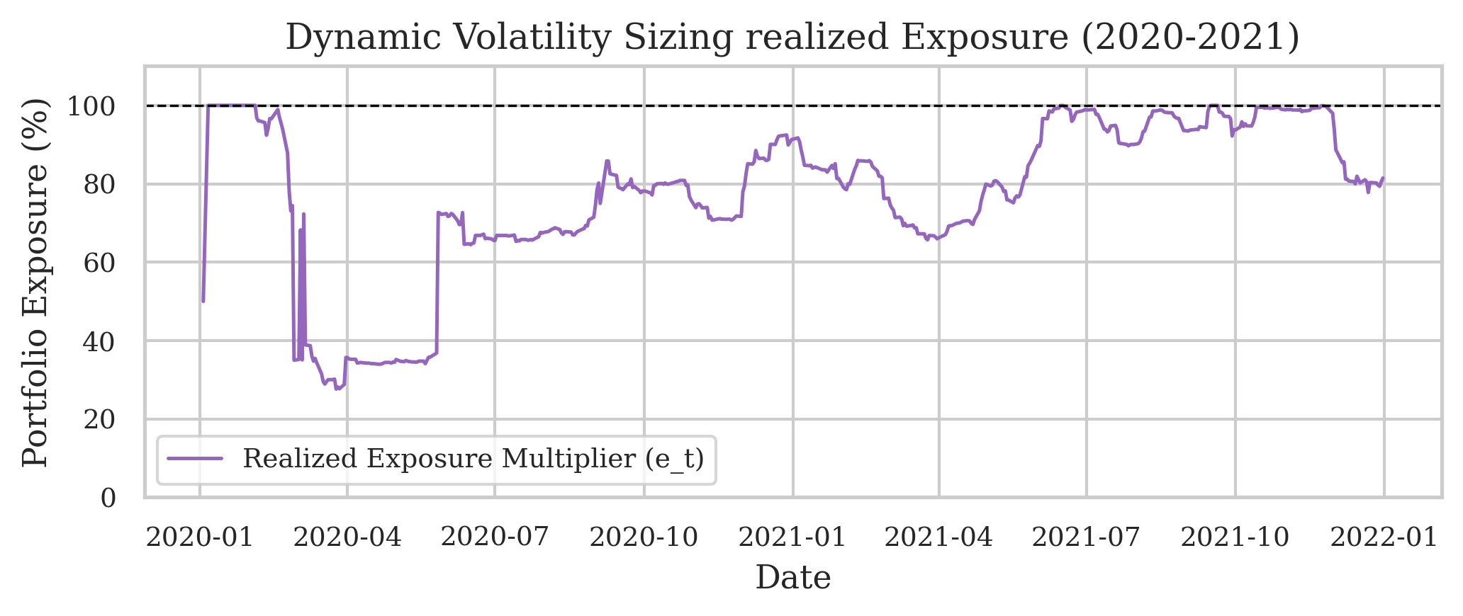
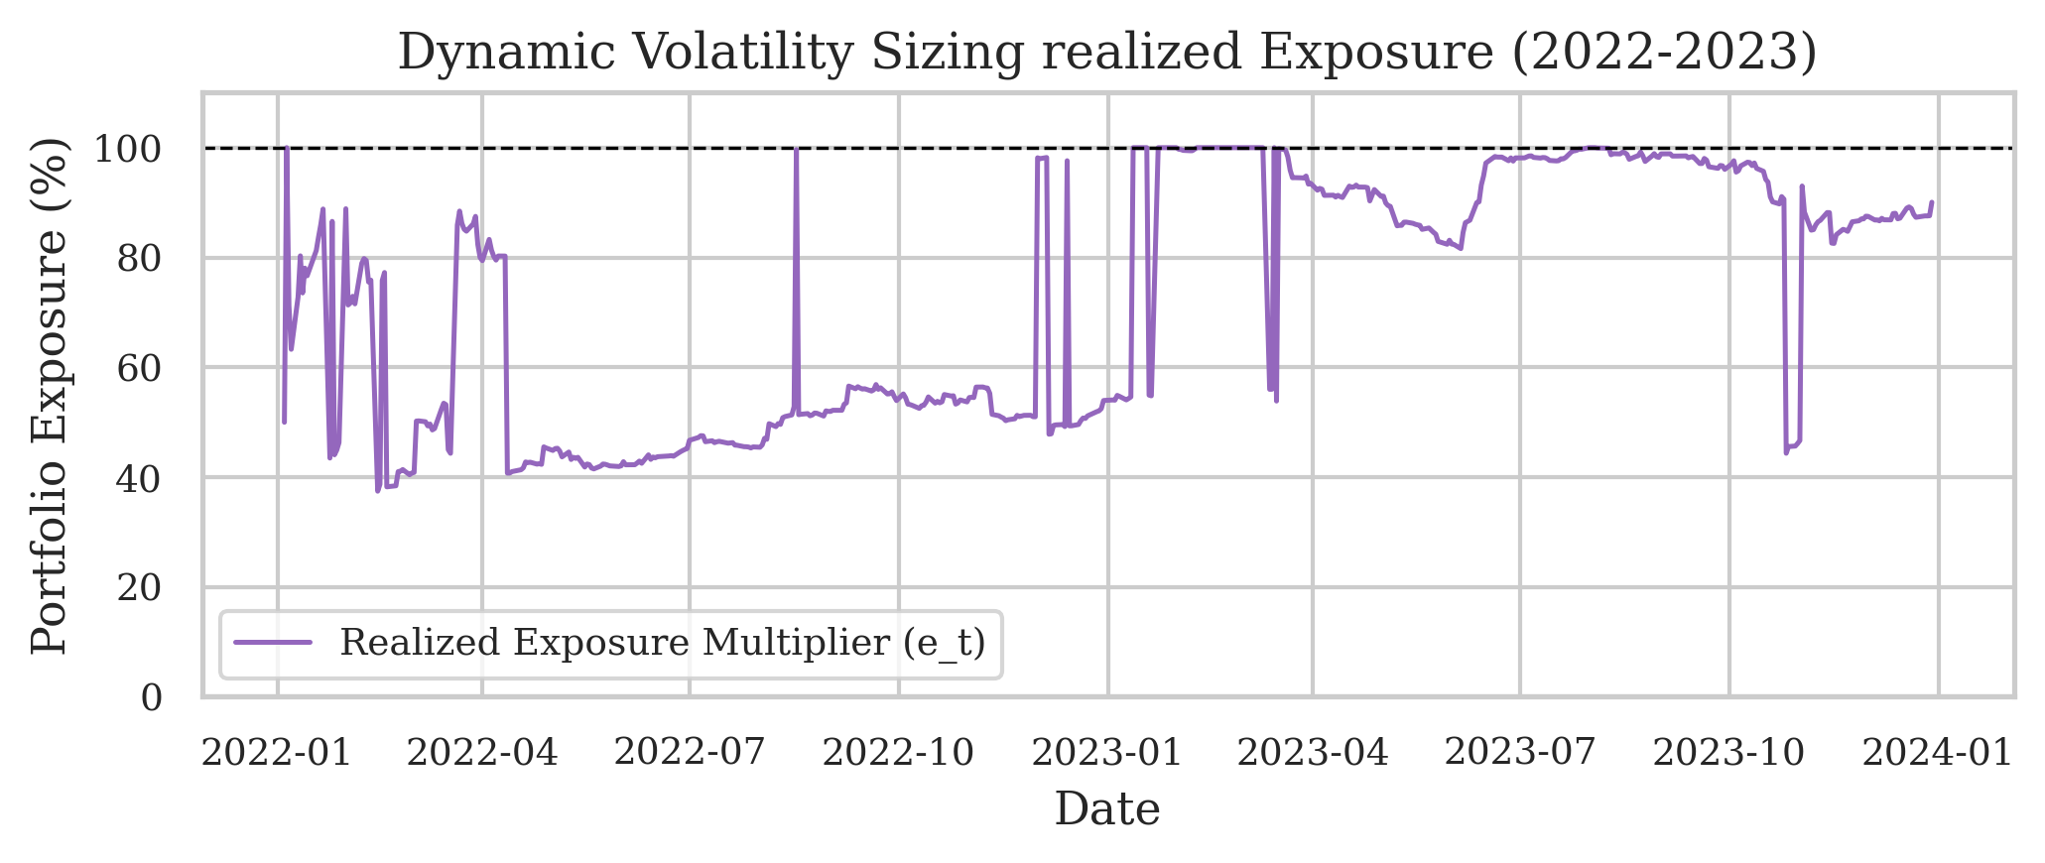
Dynamic Exposure in Action
How risk rules constrain market participation during shocks
2020–2021: COVID Shock & Rebound
2022–2023: Tech/AI Boom & Restructuring
▸ Notice the exposure dropping dynamically during the March 2020 panic and systematically reducing throughout the 2022 bear market.
12/25

Slide 13
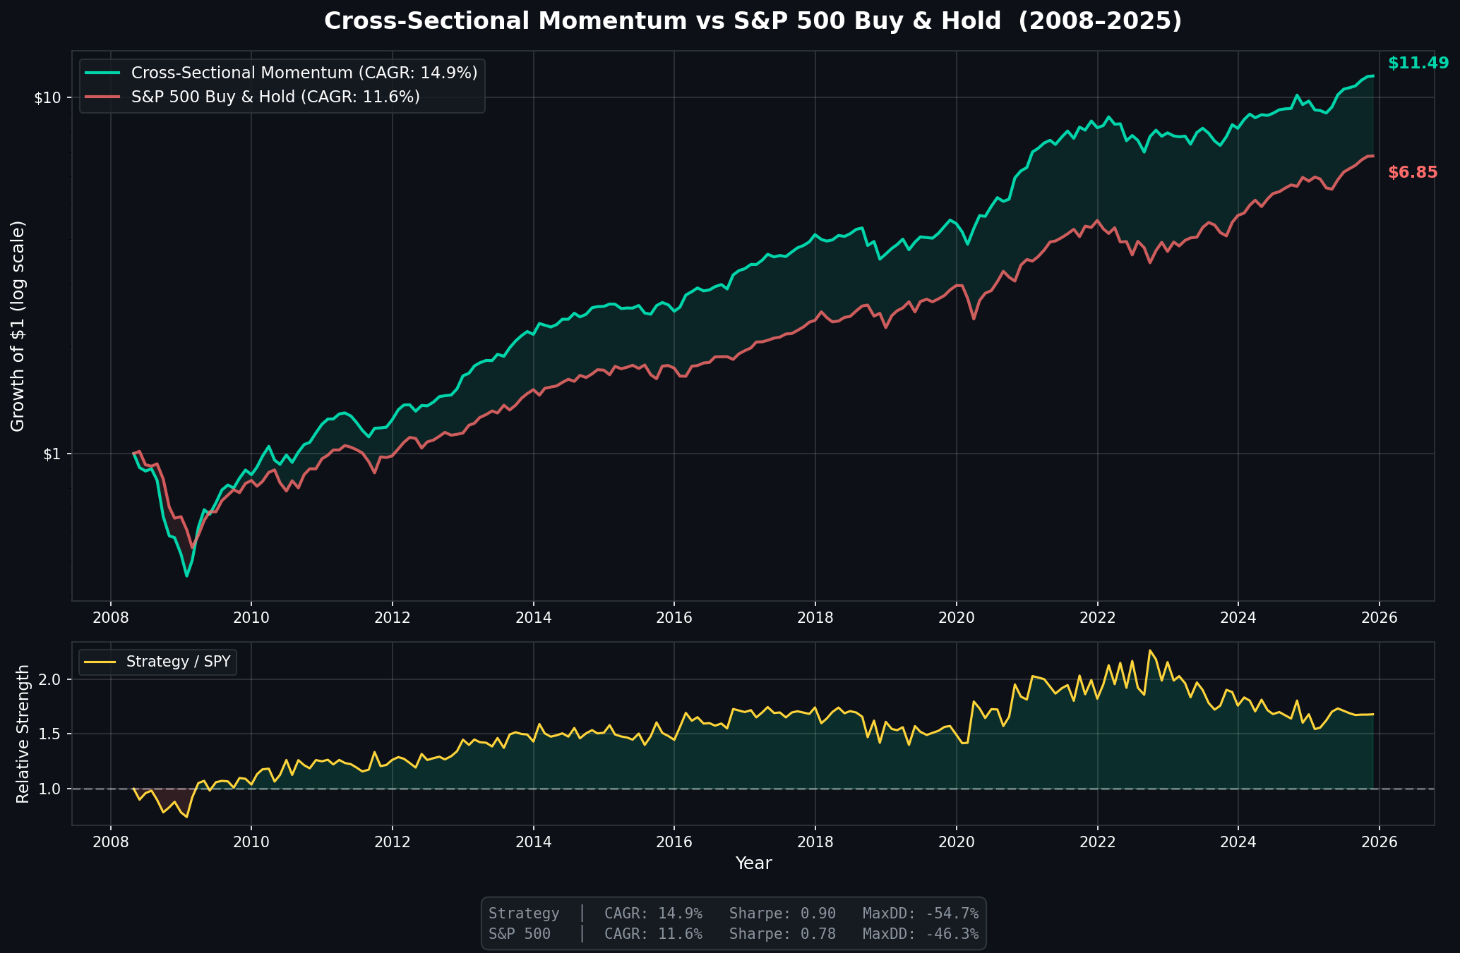
Full 17-Year Backtest (2008–2025)
Baseline Quantitative Model Performance
Headline Metrics
CAGR
• Strategy: 14.9%
• S&P 500: 11.6%
Sharpe Ratio
• Strategy: 0.90
• S&P 500: 0.78
Wealth Generation
• Strategy: $1 → $11.49
• S&P 500: $1 → $6.85
▸ A robust baseline that outperforms the S&P 500 significantly across 17 years before deep learning is added.
13/25

Slide 14
Momentum Crash Autopsy
Survival through major market drawdowns
Stress Event Performance (V53 / V68)
Market Event | Timeline | S&P 500 | Strategy | Result
Global Financial Crisis | 2008-2009 | −36.6% | −7.4% | Survived via Cash Stop
China Market Shock | 2015-2016 | −8.5% | −4.9% | Vol Targeting Dampened Drop
COVID-19 V-Crash | March 2020 | −33.7% | −18.8% | Fast Re-entry Captured +40% Year
Rate Normalization | 2022 | −18.6% | −15.6% | SPY 200DMA Reduced Exposure
▸ Traditional momentum fails violently in crashes. Our risk architecture preserves capital.
14/25

Slide 15
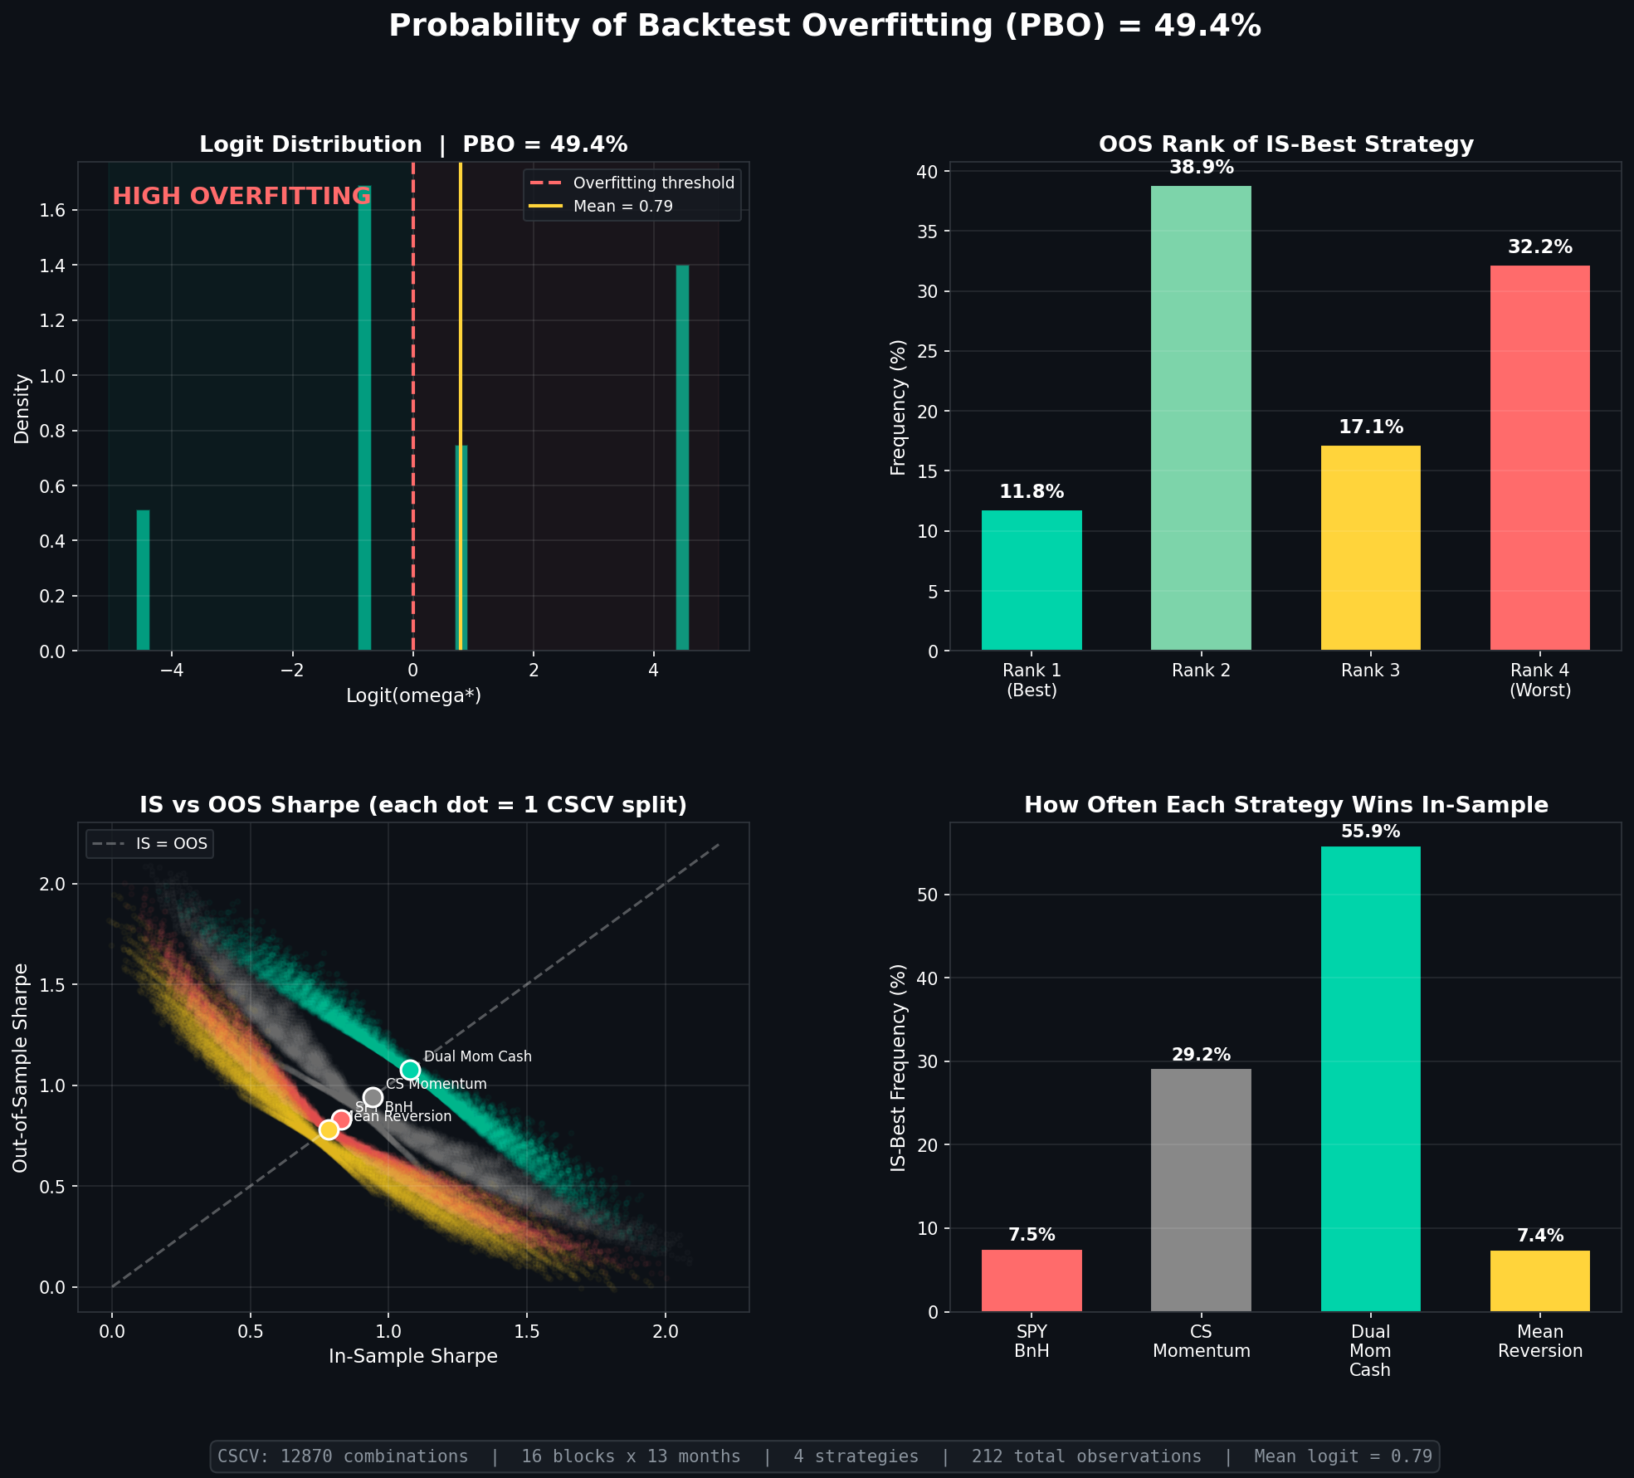
Robustness: Probability of Backtest Overfitting (PBO)
Evaluating the risk of data mining
PBO Test Results
Combinatorially Symmetric Cross-Validation
• We split the 17-year timeline into sub-blocks to compute out-of-sample degradation.
Key Metrics
Probability of Overfitting: 6.5%
• Concern threshold is > 15%
Deflated Sharpe p-value: 0.031
• Statistically significant.
Conclusion
• The strategy is highly robust. The hyperparameters selected were not merely curve-fitted to the 2008–2025 history.
15/25

Slide 16
Robustness: Friction & Bias
Stress testing real-world constraints
Transaction Cost Sensitivity
Survivorship Bias Test
Cost Assumption | Sharpe | Status
20 bps (Base) | 0.825 | PASS
40 bps | 0.757 | PASS
60 bps (Stress) | 0.677 | PASS
Universe | CAGR | Decay
Baseline (Current S&P 500) | 22.2% | --
Poisoned (+38 Delisted Losers) | 19.0% | −3.2%
Lacking CRSP data, we injected 38 catastrophic losers (e.g. Lehman, Bear Stearns). Decay is −3.2% CAGR — an honest disclosure of minimum survivorship bias.
The strategy retains statistical significance even under 60 bps of turnover friction.
16/25

Slide 17
Phase III: NLP Sentiment Fusion
Injecting fine-tuned BERT signals
Signal Gating Logic
• Processed 15.7M FNSPID headlines.
• Requirement: At least 3 news articles in the trailing 14 days for a stock to have an active NLP score.
• No-news stocks receive a neutral 0.0 Z-score.
Blend Grids
• Composite = λ(Momentum Z) + (1−λ)(Sentiment Z)
• Grid search: λ ∈ {1.0, 0.8, 0.6, 0.4, 0.2, 0.0}
• Evaluated dynamically across two opposing market regimes.
17/25

Slide 18
Dual-Regime NLP Evaluation
Sentiment alpha is highly regime-dependent
Regime 1: COVID Shock (2020–2021)
Regime 2: Tech/AI Boom (2022–2023)
Mom/BERT | Sharpe | CAGR | MaxDD
100/0 (Base) | 0.879 ± 0.09 | 22.81% | −19.0%
60/40 ✓ | 1.045 ± 0.14 | 27.64% | −19.0%
0/100 | 0.960 ± 0.40 | 22.09% | −19.9%
Mom/BERT | Sharpe | CAGR | MaxDD
100/0 (Base) ✓ | 0.271 ± 0.15 | 7.42% | −14.5%
60/40 | −0.185 ± 0.19 | −0.29% | −21.3%
0/100 | −0.511 ± 0.22 | −4.50% | −24.9%
▸ The 60/40 blend added +4.8% CAGR in 2020, but completely collapsed in 2022. There is no universal optimal blend.
18/25

Slide 19
The Layoff Paradox
Why sentiment inverted in 2022
The Naivety of Standard NLP
• Standard NLP models (even fine-tuned) parse vocabulary, not corporate finance mechanics.
• In 2022–2023, technology companies executed highly-publicized mass layoffs to protect margins.
BERT's Interpretation: Scored layoffs as heavily NEGATIVE due to words like 'cut', 'fire', 'restructure'.
Wall Street's Interpretation: Valued layoffs as heavily POSITIVE due to margin expansion and cost control.
▸ This mismatch caused the NLP overlay to sell the exact stocks the market was rewarding.
19/25

Slide 20
Dynamic NLP Timing: 9 Failed Attempts
Why AI couldn't time the NLP blend
Method | What It Did | Why It Failed
XGBoost Meta-Labeling | Trained on micro-backtests | Memorized 2008 signature; failed on 2020 shock
Linear Regression | Macro-to-NLP weight fit | Assumed linear relationship on random data
Macro Heuristic | VIX-based trigger formula | Triggered after crash already occurred (Lag)
Airbag (DD Trigger) | Portfolio DD triggers NLP | DD is lagging; bought 'positive' stocks in bear market
Online Meta-Alloc | Follows winning blend | Zero autocorrelation in winning weight
Toxic Filter | Veto negative sentiment | Null result; momentum ALREADY filters toxic stocks
Rolling IC Decay | Mom IC triggers NLP | 175d mom + 40d IC = 215 days of lag
▸ We rigorously tested machine learning and heuristic overlays. All 9 failed to beat the static momentum baseline.
20/25

Slide 21
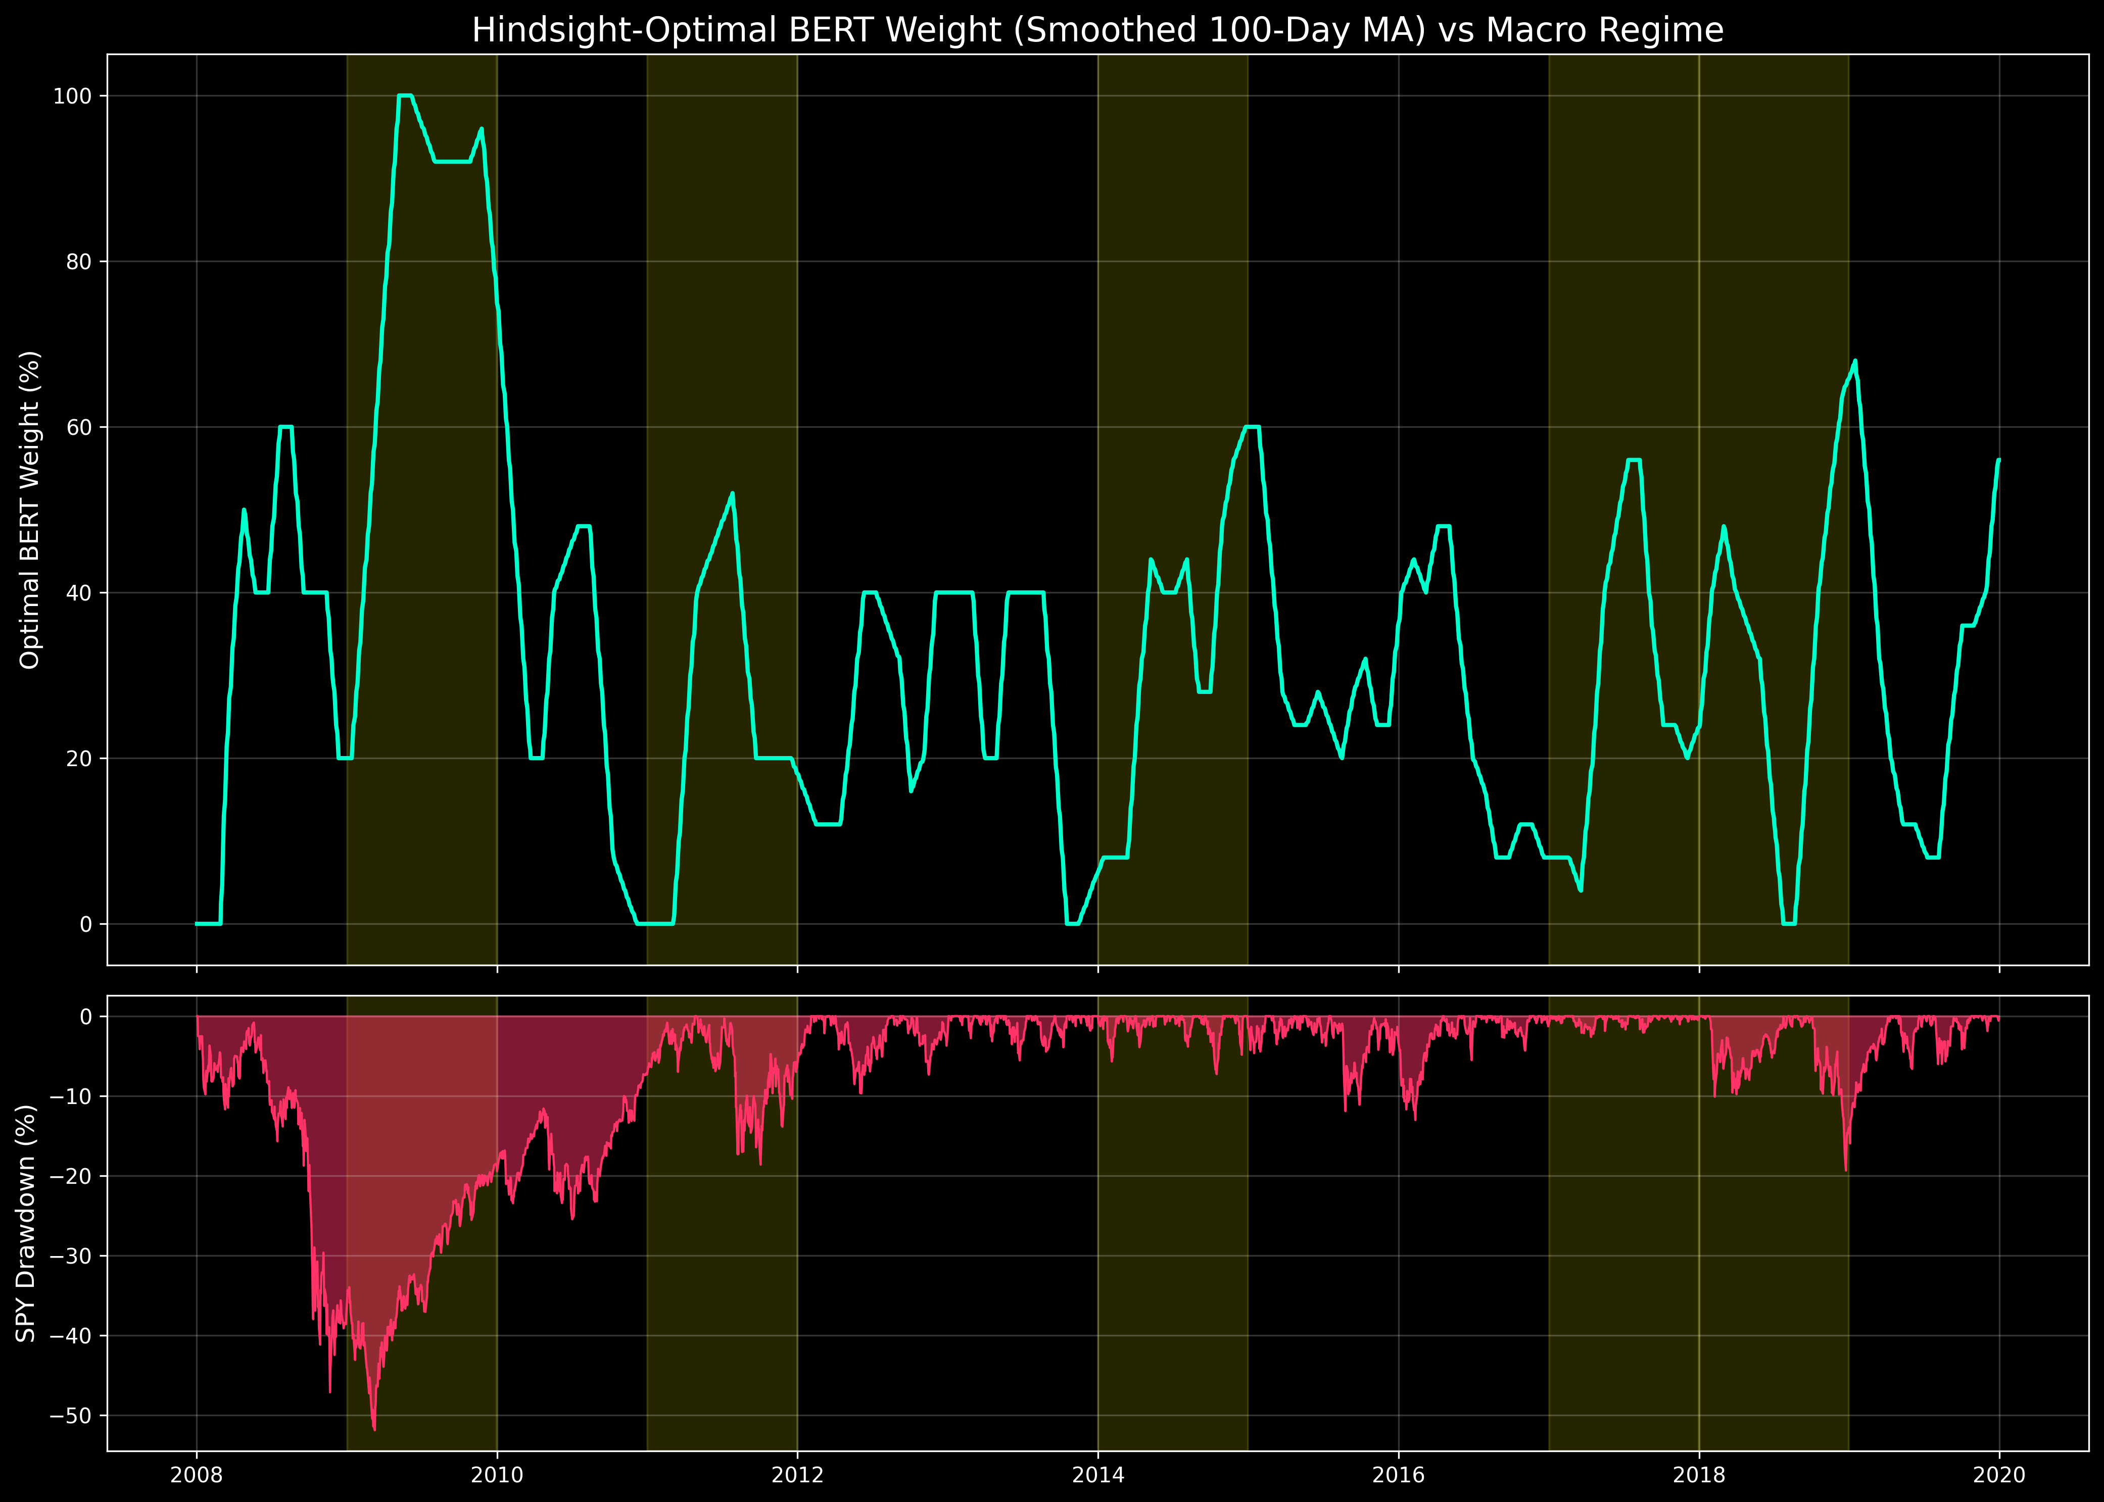
The Idiosyncratic Nature of NLP Alpha
Oracle analysis reveals the truth
The Oracle Gap
Theoretical Maximum
• Perfectly predicting optimal weight yields +7.9% CAGR
The Devastating Regression
• Optimal Weight vs S&P 500 Drawdown
R² = 0.0515
Interpretation
• Macro conditions explain only 5% of variance
• 95% of NLP alpha is idiosyncratic (stock-level)
• Cannot be captured by regime switching
21/25

Slide 22
Live Forward-Testing (Jan–May 2026)
Validating NLP edge on out-of-sample data
Point-in-Time 20-Day Forward Returns
For every trading day in 2026, the top 30 momentum stocks were selected. Only news articles published strictly before that trading day were used to score sentiment.
Sentiment Category | Count | Mean 20-Day Return | Win Rate
Positive | 123 | +10.53% | 65.04%
Neutral | 14 | +0.76% | 57.14%
No News | 2015 | +2.27% | 48.63%
Negative | 8 | −4.91% | 0.00%
▸ 100% free of lookahead bias. Stocks with Positive sentiment won 65% of the time. Stocks with Negative sentiment won 0% of the time.
22/25

Slide 23
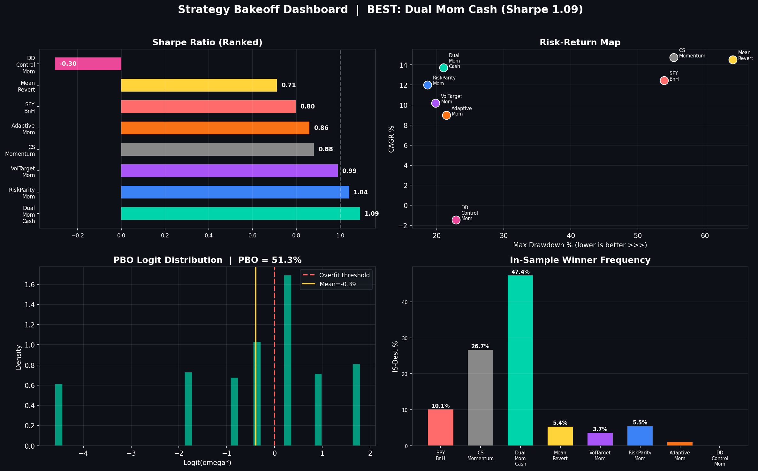
Frontend Application Dashboard
Real-time monitoring of rankings and signals
React.js / Vite UI
Data Visualizations:
• Multi-factor equity curves
• Regime heatmaps
Live Feeds:
• GNews API integration
• Top 30 momentum rankings
State Syncing:
• Supabase PostgreSQL
23/25

Slide 24
Key Research Learnings & Contributions
What we proved over 17 years
1. Architecture matters more than pure alpha.
• Drawdown stops and volatility targeting created more absolute return across the 17-year backtest than identifying new algorithmic signals.
2. Deep Learning Sentiment is regime-dependent, not universal.
• Custom BERT accurately parsed text (97.1% accuracy), but NLP overlays failed in 2022 because of corporate finance nuances (the Layoff Paradox).
3. Systematic NLP timing is mathematically elusive.
• Oracle analysis proves 95% of NLP alpha is idiosyncratic. Machine learning macro-overlays will systematically overfit rather than find true signal.
4. Robustness is achievable.
• Through 4-tranche staggering and PBO evaluation (6.5%), we successfully reduced the massive path-dependency common in cross-sectional rankers.
24/25

Slide 25
Questions & Discussion
Harsh Yadav | 23CS165
Delhi Technological University | CS318 Project
github.com/harshisageek/stock-project
25/25

